Slide 1
How to develop a consistent and intelligent approach to measuring the performance of your department
Scottsdale Performance Management Team
http://citylink.ci.scottsdale.az.us/Toolbox/PerfMgmt
http://www.scottsdaleaz.gov/departments/citymanager/performance

Slide 2
Measuring what matters
…improving results by integrating objective evidence with decision-making processes
“What matters is not finding the perfect indicator, but settling upon a consistent and intelligent method of assessing your output results and then tracking your trajectory with rigor.”
“…rigorously assemble evidence – quantitative or qualitative – to track your progress.”
Jim Collins. 2005. Good to Great and the Social Sectors.

Slide 3
Outcome Model
IN SUPPORT OF A GOAL
TO ACHIEVE RESULTS
TO BENEFIT CUSTOMERS
TO DELIVER SERVICES
TO CONDUCT ACTIVITIES
WE USE RESOURCES

Slide 4
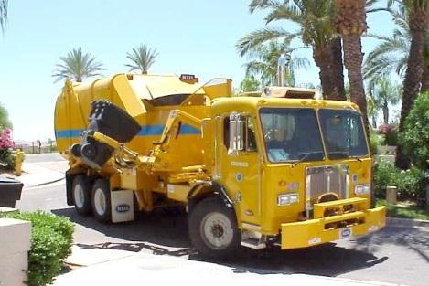
Internal Services
Outcome Model
(Modified to Include
Internal Services)
IN SUPPORT OF A GOAL
TO ACHIEVE RESULTS
TO BENEFIT CUSTOMERS
Public Services
TO DELIVER SERVICES
TO CONDUCT ACTIVITIES
WE USE RESOURCES
TO CONDUCT ACTIVITIES
TO DELIVER SERVICES
TO PROVIDE RESOURCES

Slide 5
TO ENHANCE NEIGHBORHOODS
TO ENCOURAGE A CLEAN, SUSTAINABLE ENVIRONMENT
FROM EVERY RESIDENT’S CURB OR ALLEY
TO COLLECT REFUSE AND RECYCLING
DRIVE TO EACH HOUSE TWICE A WEEK
DRIVERS AND TRUCKS

Slide 6
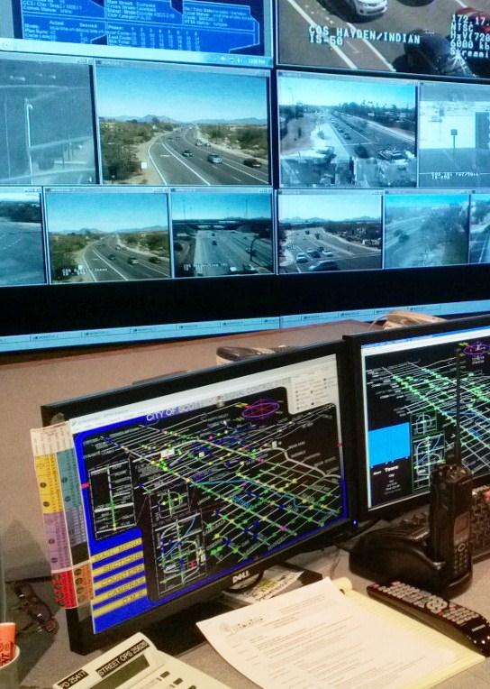
To “Advance Transportation”
To avoid collisions
To discourage unreasonable speeds AND ALERT DRIVERS TO POTENTIAL HAZARDS
TO KEEP SIGNALS AND SIGNAGE OPERATIONAL
TO REPAIR & MAINTAIN SIGNS AND SIGNALS
STAFF USE FUNDS
AND EQUIPMENT

Slide 7
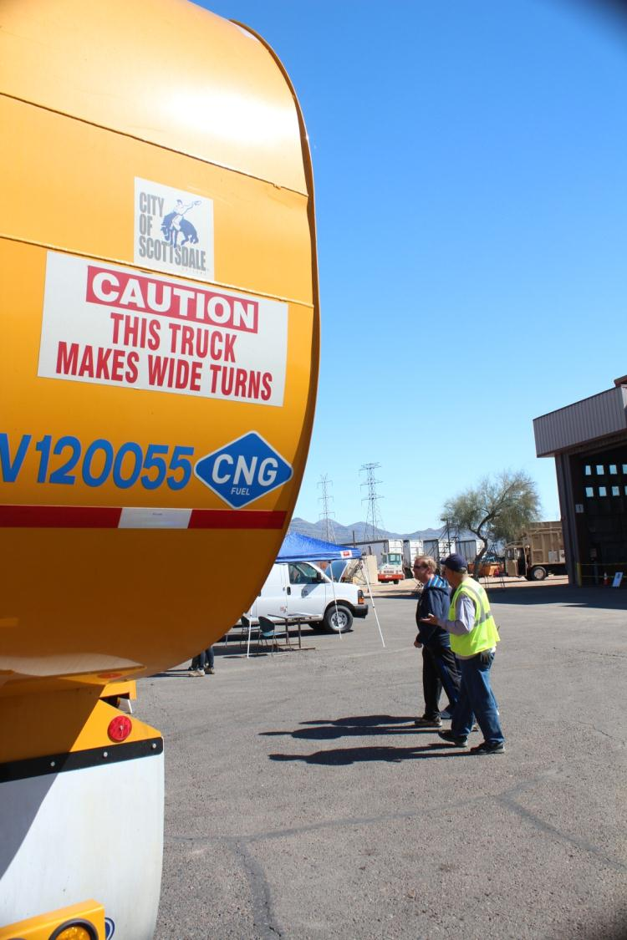
TO ENHANCE NEIGHBORHOODS
TO ENCOURAGE A CLEAN, SUSTAINABLE ENVIRONMENT
FROM EVERY RESIDENT’S CURB OR ALLEY
TO COLLECT REFUSE AND RECYCLING
CAN DRIVE TO EACH HOUSE TWICE A WEEK
USE TECHS AND TOOLS
TO REPAIR AND MAINTAIN VEHICLES
TO KEEP THEM OPERATING EFFECTIVELY
SO THAT DRIVERS AND TRUCKS

Slide 8
TO ENHANCE NEIGHBORHOODS
AND PROMOTE SELF-SUFFICIENCY AND SUPPORT INDEPENDENT LIVING
TO AVOID EVICTION, FORECLOSURE AND UTILITY TERMINATION
TO CONNECT THEM WITH EMERGENCY ASSISTANCE AND OTHER RESOURCES
MEET WITH CLIENTS
SOCIAL WORKERS

Slide 9
TO ENHANCE NEIGHBORHOODS
TO IMPROVE OVERALL HEALTH AND WELLNESS
TO INTRODUCE KIDS TO ORGANIZED PHYSICAL ACTIVITY
TO OFFER SOCCER FOR KIDS
TO PLAN & HOST PRACTICES & GAMES
WE USE STAFF AND MOWERS
TO MOW AND FERTILIZE FIELDS
SO FIELDS ARE SAFE & WELL-MAINTAINED
WE USE STAFF, FUNDING AND FIELDS

Slide 10
Types of performance measures
Input
Amount of resources used (or available) to provide services
Output
Amount of work produced or services delivered
Outcome
The desired end result that demonstrates the impact of the services delivered
Indicators
Describe the environment in which the service is provided
Efficiency
Amount of work done per amount of resources used
Effectiveness
Amount of achieved results, or the level of quality relative to the amount of work done
Productivity
Amount of quality work done per amount of resources used
Conditions
External requirements or demands that impact service delivery
Cost-Effectiveness
Amount of outcome achieved per amount of resources used

Slide 11
Solid Waste Example
Input
Equipment Operators
Output
Tons collected per month
Outcome
Refuse is collected in a reliable and clean manner
Indicators
Number of households
Efficiency
Tons collected per month per operator
Effectiveness
Tons collected per month without complaints of missed or messy collection
Productivity
Tons of complaint-free collection per operator
Conditions
State law requiring twice per week pick-up
Cost-Effectiveness
Cost to provide residential refuse collection services per operator

Slide 12
Street Operations Example
Input
Staff
Output
Signals Repaired
Outcome
Signs and signals function correctly and are in good working order
Indicators
Number of Signals
Efficiency
Repairs per staff member
Effectiveness
Proactive repairs as a percent of total repairs or
Hours signals are out of service
Productivity
Proactive repairs
per staff member
Conditions
MUTCD Requirements
Cost-Effectiveness
Operating and maintenance cost per signal

Slide 13
Fleet Maintenance Example
Input
Technician Hours
Output
Vehicle Repairs
Outcome
Timely and complete vehicle repairs
Indicators
Number of Vehicles
Efficiency
Repairs per Technician Hour
Effectiveness
% of vehicles repaired within 1 day; % of vehicles still working properly 6 months after repair
Productivity
Time per properly repaired vehicle per technician
Conditions
ADEQ Requirements
Cost-Effectiveness
Operation and Maintenance Cost per Vehicle

Slide 14
Human Services Example
Input
Staff (FTEs)
Output
Hours of Meetings
with Clients
Outcome
Clients are self-sufficient and living independently
Indicators
Population at Low-Income Levels
Efficiency
Hours of Meetings with Eligible Clients per FTE
Effectiveness
Number of clients reporting improved financial condition
Productivity
Clients reporting improved financial condition per FTE
Conditions
DES Requirements
Cost-Effectiveness
Per Client cost to provide case management services

Slide 15
Parks and Recreation Example
Input
Staff, Fields,
Instructors, $$$,
Contract Hours
Output
# of Classes
# of Participants
Outcome
Kids participate in organized physical activity and improve their health and wellness
Indicators
Total number of residents in target age group
Efficiency
Cost per class;
Cost per participants
Participants per instructor
Effectiveness
% willing to participate again; % rating excellent or good; Seats filled vs. seats available
Productivity
Direct instruction as a % of total program hours; Hours utilized vs. hours available
Conditions
Liability insurance; CPS reporting; Classes offered by others
Cost-Effectiveness
Cost to provide class vs. cost charged to customer;
Cost per filled seat

Slide 16
Don’t settle for easy measures
“Never give up on an important goal that’s hard to measure in favor of a less important one that’s easy to measure.”
From Robert Lewis. 2009. “No metrics? Don’t fret; you can still manage without measuring.” Minneapolis St. Paul Business Journal.

Slide 17
“Evidence suggests that improved performance occurs at a much greater rate when performance measures are compared.”
Smith and Hartung, 2004
Targets express a specific level of performance the organization is aiming to achieve.
Standards (also called “benchmarks”) express the minimum acceptable level of performance that is expected and achieved by other, high-performing organizations.
How else will you know how well you are doing without context?

Slide 18
Why measure?
If You Don't Measure Results, You Can't Tell Success from Failure
If You Can’t See Success, You Can’t Reward It
If You Can’t Reward Success, You’re Probably Rewarding Failure
If You Can't See Success, You Can't Learn From It
If You Can't Recognize Failure, You Can't Correct It
If You Can Demonstrate Results, You Can Win Public Support
David Osborne and Ted Gaebler. 1992. Reinventing Government: How the Entrepreneurial Spirit Is Transforming the Public Sector.

Slide 19
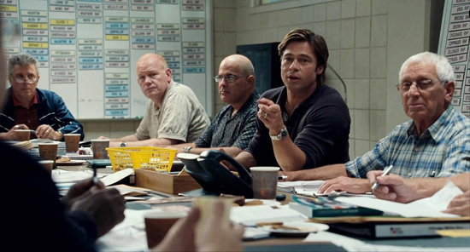
“People… operate with beliefs and biases.
To the extent you can eliminate both and replace them with data, you gain a clear advantage.”
Michael Lewis | Moneyball: The Art of Winning an Unfair Game
Moneyball (2011)

Slide 20
Today’s Goal:
develop a consistent and intelligent method to measuring performance in your department and
identify a set of initial measures to track efficiency and effectiveness of your department

Slide 21
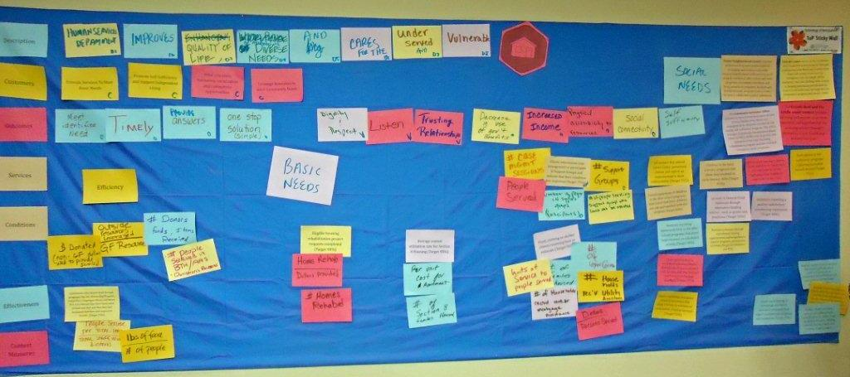
How to develop a consistent and intelligent approach to performance measurement in your department
1. What do you do? Describing your purpose
2. Why do you do it? Identifying outcomes
3. How do you do it? Counting inputs and outputs
4. How well do you do it? Measuring efficiency & effectiveness
5. Can you explain it to others?

Slide 22
Review the description of your area
Does this accurately respond to the question -
Why does your department exist?

Slide 23
Discussion: What strategic goal(s) do you help achieve? Why?
Value Scottsdale’s Unique Lifestyle and Character
Preserve Meaningful
Open Space
Support Economic Vitality
Seek Sustainability
Enhance Neighborhoods
Advance Transportation
Guiding Principles from CityShape 2020 and 2001 General Plan

Slide 24
Who are your customers?
Write down one customer that you serve
A customer is an actual or potential user of your organization’s products, programs or services.
Can be direct, or indirect

Slide 25
What desired results are you trying to achieve?
Write down a desired result (outcome) that your organization is striving to achieve from the perspective of each customer.
Desired results describe the ultimate benefit to your customers from the work you do

Slide 26
What services do you provide?
These are the significant services your department provides, as listed in the budget book.

Slide 27
What are your top priority services?
Consider these questions in selecting your top three priority services
Which service benefits the most customers?
Which service can only be received from your organization?
Which service uses the most resources ($$$, time, staff)?
Which service is most closely identified with your organizational unit?

Slide 28
What external indicators or conditions impact how you provide services?
Includes such things as:
Legal requirements
Government regulations
Number and types of customers/calls for service
What external requirements or demands impact what you do and why you do it?

Slide 29
Developing measures
What resources (inputs) do you have available?
What activities (outputs) do you perform?
Thinking about your outcomes, which activities most impact your outcome?

Slide 30
Efficiency / Effectiveness
How can you best measure the efficiency of your area?
How can you best measure the effectiveness of your area?
Thinking back to your description, which combinations of measures lead to the best overall snapshot of performance in your area?

Slide 31
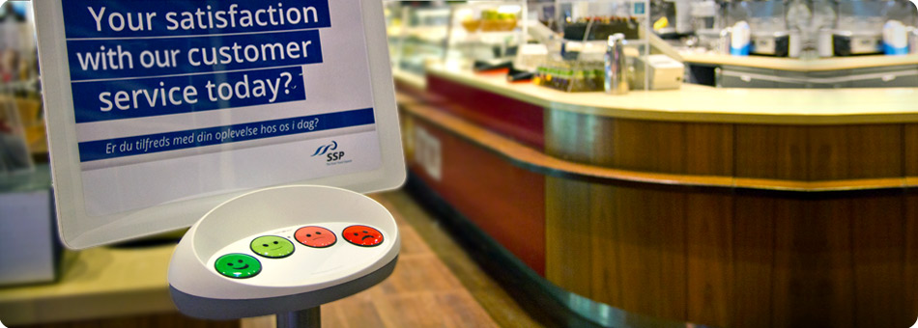
Some ways to measure effectiveness

Slide 32
Restroom Cleanliness Evaluation |  |  |  | Date: / / /
Check Points | Wt | Score % | Wted Score % | RR #: _______
Toilets/urinals clean | 25 | 85% | 21% | Inspected by:
Sinks clean | 15 | 90% | 14%
Floor clean | 10 | 50% | 5%
Mirror clean | 10 | 100% | 10%
Paper products in place | 25 | 80% | 20%
No trash on floors/counters | 15 | 100% | 15%
Totals | 100 |  | 85%
Notes:
1. Criteria must be designed and used for evaluating each Check Point. The inspector fills in a score for each Check Point (in blue above).
2. The weighted score for each Check Point is found by multiplying the [Wt X Score %] (in red above). The Total Weighted Score % provides a measure of the restroom cleanliness based on the weighted scores of each Check Point.
3. Scores can be compared by dates to assess trends (up or down).
4. Scores may also be compared for different restrooms.
5. This method is useful for establishing a measure for elements that are subjective, i.e., a matter of judgment.

Slide 33
Review your proposed measures through three filters to determine it’s a consistent and intelligent approach. 1. From your customers perspective 2. From the organization’s perspective (management and employees) 3. From the City Council’s perspective Is this relevant, understandable and complete? If not, what changes are needed?
Does this make sense to others?

Slide 34
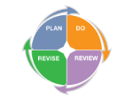
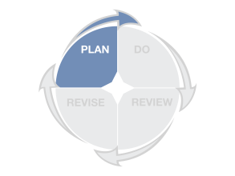
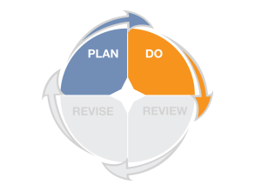
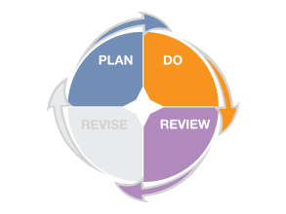
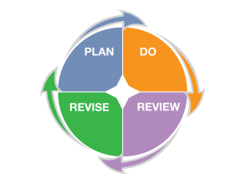
What are we asking you to do?
1. Review services to ensure they are linked to the strategic and/or general plan goals, and make adjustments as needed
2. Review existing measures to ensure you are measuring the efficiency, effectiveness, and cost-effectiveness of services and create new measures, if needed
3. Identify standards and targets for each measure to ensure that you have context for evaluating success
4. When measures do not meet identified targets or standards, develop objectives, initiatives and measures to improve performance

Slide 35
Questions, Comments, Observations?
Scottsdale Performance Management Team
http://citylink.ci.scottsdale.az.us/Toolbox/PerfMgmt
http://www.scottsdaleaz.gov/departments/citymanager/performance

