Slide 1
Accomplishing Results
Aligning measures with mission and goals
Photo by Scott Amonson
M. Brent Stockwell | Asst. City Manager
480-312-7288 | Bstockwell@ScottsdaleAZ.gov
go to ScottsdaleAZ.gov search “about”

Slide 2
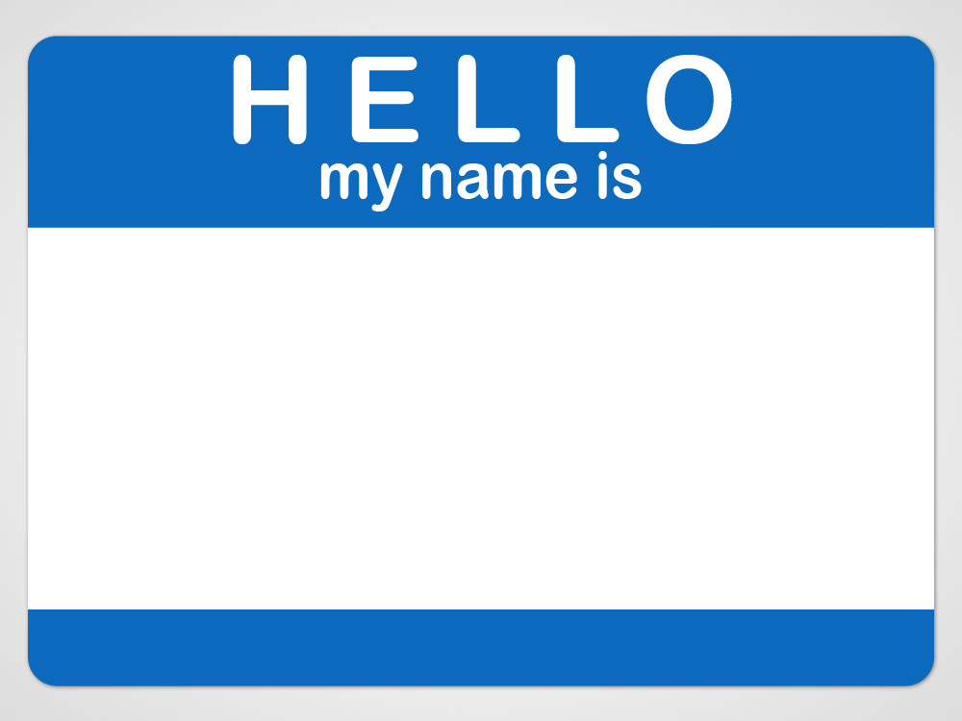
Brent Stockwell
Assistant City Manager

Slide 3
Who are you? What you do?
What do you hope to gain from this class today?

Slide 4
“..the only measure of a great team – or a great organization – is whether it accomplishes what it sets out to accomplish.”
Patrick Lencioni

Slide 5
What have you
set out to accomplish?

Slide 6
“What matters is not finding the perfect indicator, but settling upon a consistent and intelligent method of assessing your output results and then tracking your trajectory with rigor.”
Jim Collins

Slide 7
Performance management is
an organization-wide effort to improve results by integrating objective evidence with decision-making processes

Slide 8
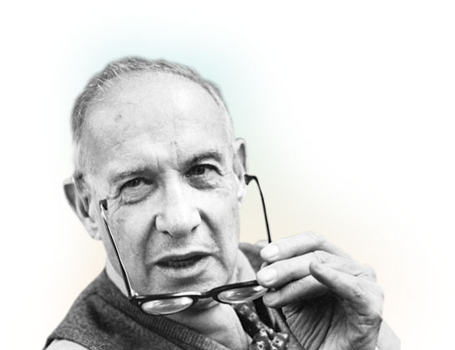
“What gets measured, gets managed.”
Peter Drucker

Slide 9
Exercise – what might you measure?

Slide 10
Learning and Growth
Innovation and Improvement
Accountability
and Transparency
Budgeting and
Decision-making

Slide 11
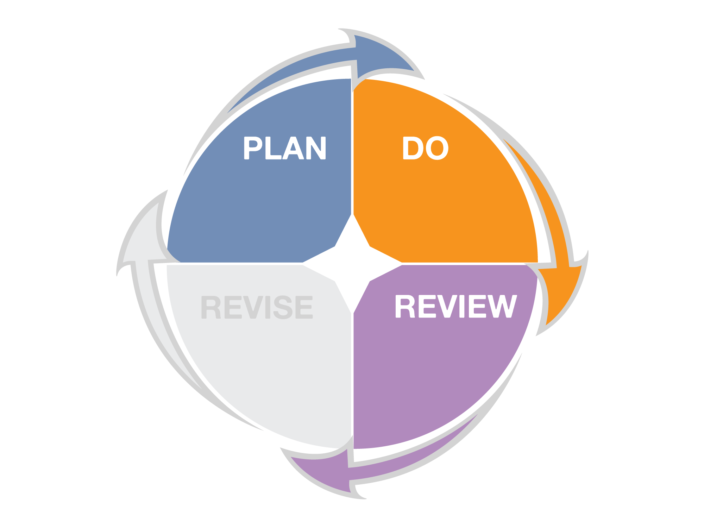
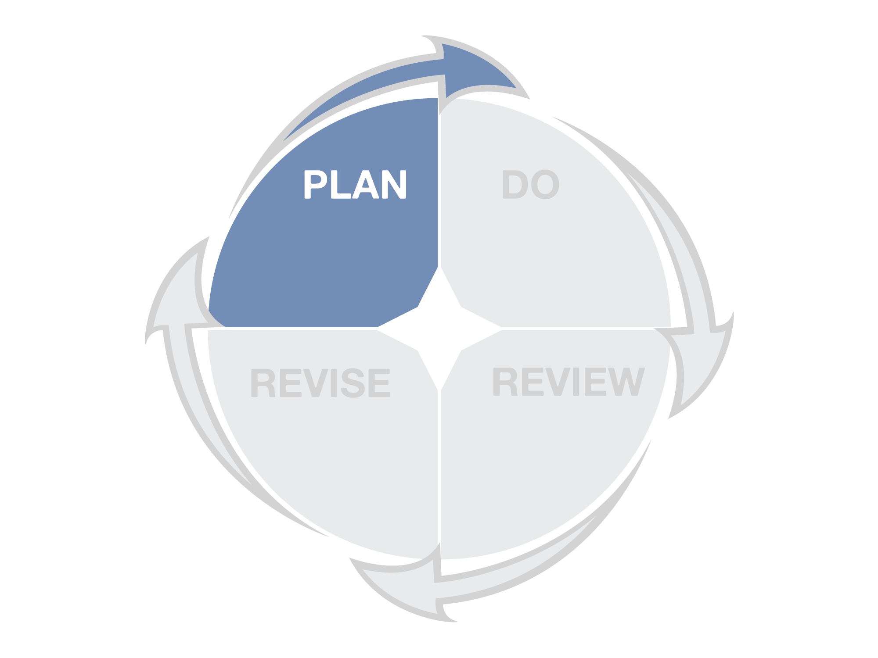
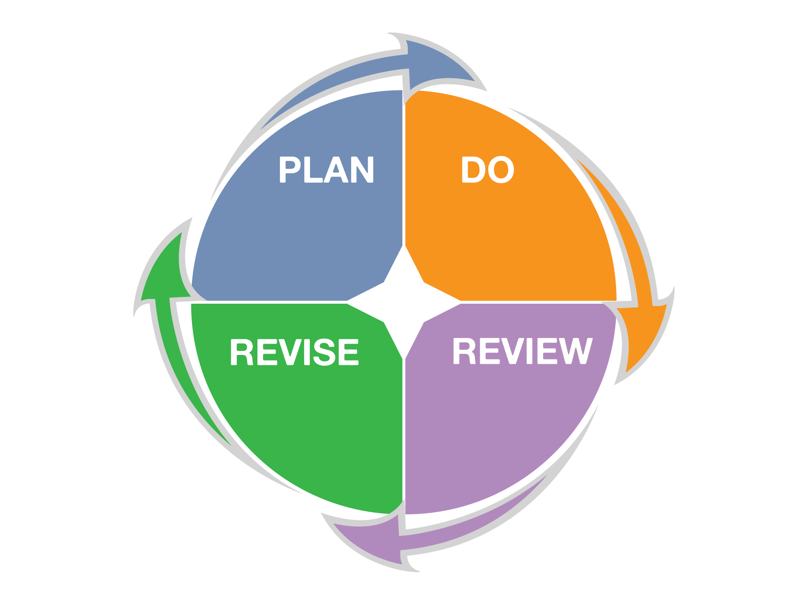
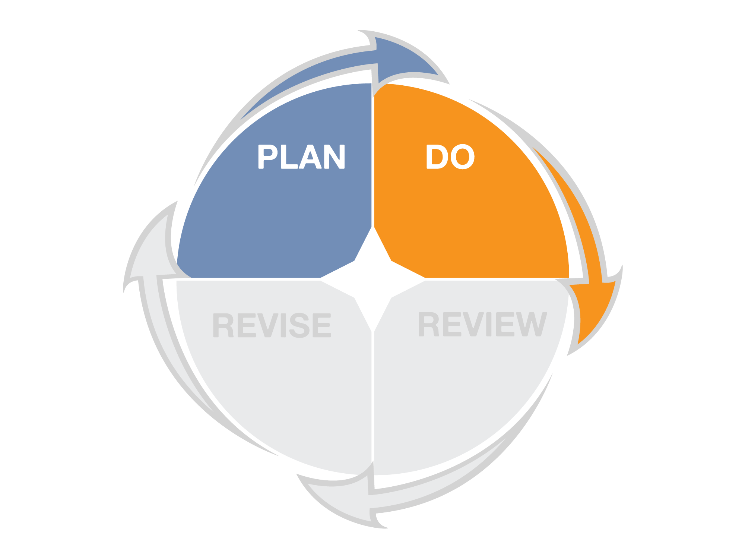
DEFINE
RESULTS
DEFINE
RESULTS
ACHIEVE
RESULTS
ACHIEVE
RESULTS
IMPROVE
RESULTS
IMPROVE
RESULTS
ASSESS
RESULTS
ASSESS
RESULTS

Slide 12
Start
with
Why
WHY
HOW
WHAT
Adapted from The Golden Circle, Simon Sinek, Start with Why

Slide 13
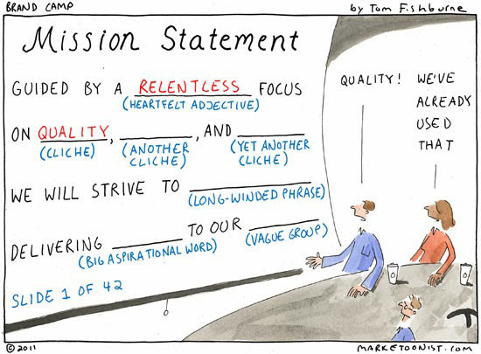

Slide 14
Good mission statements:
Are short and sharply focused
State why we do what we do
Provide direction for doing the right things
Are clear and easily understood
Are memorable and easily memorizable
Describe what we want to be remembered for

Slide 15
“The effective mission statement is short and sharply focused. It should fit on a t-shirt.”
Peter Drucker

Slide 16
Mission Statement
The mission of ______________________________________ (name of group)
is to ______________________________________________ (key services delivered)
to / for _____________________________________________ (customers)
so that ____________________________________________. (results to be achieved)

Slide 17
Mission Statement (Example)
The mission of ______________________________________ (name of group)
is to ______________________________________________ (key services delivered)
to / for _____________________________________________ (customers)
so that ____________________________________________. (results to be achieved)
the Solid Waste Department
provide refuse and recycling collection
residents and businesses
there is a clean sustainable environment

Slide 18
Exercise - Mission Statement
The mission of ______________________________________ (name of group)
is to ______________________________________________ (key services delivered)
to / for _____________________________________________ (customers)
so that ____________________________________________. (results to be achieved)

Slide 19
Mission
Why do we exist? What is our purpose?
Goals
What are our main focus areas to achieve the mission?
Objectives
What specific actions are needed to achieve the goals?
Initiatives
What specific projects are needed to achieve the objectives?
Measures
How will we know if we are achieving results?

Slide 20
GOALS are results-oriented and help achieve the mission
OBJECTIVES are action-oriented and help attain goals
INITIATIVES are managed as projects and support attainment of organizational goals and objectives

Slide 22
WE ACHIEVE RESULTS
THAT BENEFIT CUSTOMERS
BY DELIVERING SERVICES
BY CONDUCTING ACTIVITIES
THAT USE RESOURCES

Slide 23
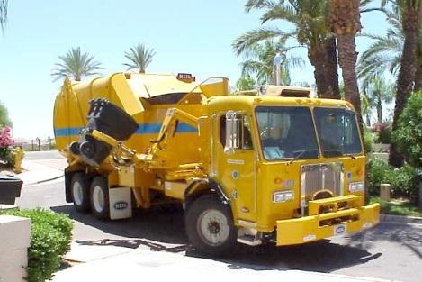
Internal Services
WE ACHIEVE RESULTS
Public Services
THAT BENEFIT CUSTOMERS
BY DELIVERING SERVICES
BY CONDUCTING ACTIVITIES
THAT USE RESOURCES
BY CONDUCTING ACTIVITIES
BY DELIVERING SERVICES
THAT USE RESOURCES

Slide 24
WE ENCOURAGE A CLEAN, SUSTAINABLE ENVIRONMENT
FROM EVERY HOUSEHOLD
BY COLLECTING REFUSE AND RECYCLING
BY DRIVING TO EACH HOUSE TWICE A WEEK
WITH DRIVERS AND TRUCKS

Slide 25
WE ENCOURAGE A CLEAN, SUSTAINABLE ENVIRONMENT
FROM EVERY HOUSEHOLD
BY COLLECTING REFUSE AND RECYCLING
BY DRIVING TO EACH HOUSE TWICE A WEEK
WITH TECHS
AND TOOLS
BY REPAIRING AND MAINTAINING VEHICLES
THAT ARE KEPT OPERATING EFFECTIVELY
WITH DRIVERS AND TRUCKS

Slide 26
WE ENCOURAGE A CLEAN, SUSTAINABLE ENVIRONMENT
FROM EVERY HOUSEHOLD
BY COLLECTING REFUSE AND RECYCLING
BY DRIVING TO EACH HOUSE TWICE A WEEK
WITH ANALYSTS, COMPUTERS AND WEBSITES
BY RECRUITING APPLICANTS
THAT ARE QUALIFIED DRIVERS
WITH DRIVERS AND TRUCKS

Slide 27
WE PROMOTE SELF-SUFFICIENCY AND SUPPORT INDEPENDENT LIVING
BY HELPING RESIDENTS AVOID EVICTION, FORECLOSURE AND UTILITY TERMINATION
BY CONNECTING THEM WITH EMERGENCY ASSISTANCE AND OTHER RESOURCES
BY MEETING WITH CLIENTS
WITH SOCIAL WORKERS

Slide 28
WE IMPROVE OVERALL HEALTH AND WELLNESS
BY PROVIDING ORGANIZED PHYSICAL ACTIVITY
BY OFFERING
YOUTH SPORTS PROGRAMS
BY PLANNING & HOSTING
PRACTICES & GAMES
WITH RECREATION STAFF, FUNDING AND FIELDS

Slide 29
WE IMPROVE OVERALL HEALTH AND WELLNESS
BY PROVIDING ORGANIZED PHYSICAL ACTIVITY
BY OFFERING
YOUTH SPORTS PROGRAMS
BY PLANNING & HOSTING
PRACTICES & GAMES
WITH STAFF AND MOWERS
BY MOWING AND FERTILIZING FIELDS
SO FIELDS ARE SAFE & WELL-MAINTAINED
WITH RECREATION STAFF, FUNDING AND FIELDS

Slide 30
WE CREATE AN INFORMED, LITERATE AND ENGAGED COMMUNITY
BY GIVING SCOTTSDALE RESIDENTS ACCESS TO INFORMATION, KNOWLEDGE AND IDEAS
BY PROVIDING MATERIALS
FOR USE BY THE COMMUNITY
BY SELECTING AND PURCHASING BOOKS AND ELECTRONIC RESOURCES
WITH STAFF, FUNDS AND TECHNOLOGY

Slide 31
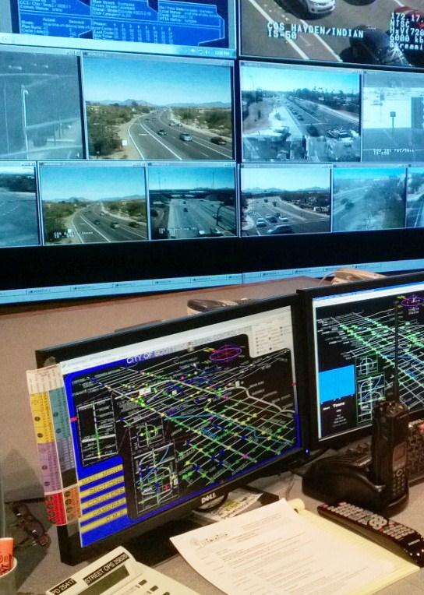
WE avoid collisions
BY discouraging unreasonable speeds AND ALERTING DRIVERS TO POTENTIAL HAZARDS
BY KEEPING SIGNALS AND SIGNAGE OPERATIONAL
BY REPAIRING & MAINTAINING SIGNS AND SIGNALS
WITH EMPLOYEES AND EQUIPMENT

Slide 32
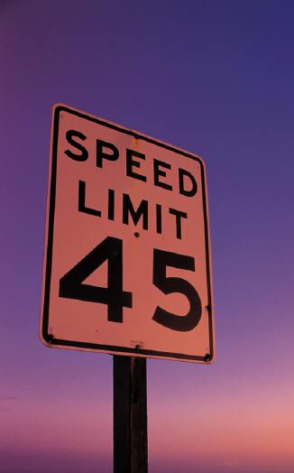
WE MANAGE TRAFFIC TO AVOID COLLISIONS AND DISCOURAGE UNREASONABLE SPEEDS
SO THAT TRAVEL TIMES ARE REASONABLE, PREDICTABLE AND COLLISION-FREE
BY ISSUING TRAFFIC CITATIONS TO THOSE WITH UNREASONABLE SPEEDS
BY ENFORCING SPEED LIMITS ON STREETS THROUGH REGULAR PATROLS
WITH TRAINED OFFICERS, VEHICLES, AND TECHNOLOGY

Slide 33
WE PROVIDE A SAFE CITY
WITH A LOW CRIME RATE
BY BRINGING OFFENDERS TO JUSTICE
BY CONDUCTING THOROUGH CRIMINAL INVESTIGATIONS
BY RESPONDING TO CALLS FOR SERVICE
WITH POLICE PERSONNEL
AND VEHICLES

Slide 34
WE ACHIEVE RESULTS
BY CUSTOMER BENEFIT
BY CUSTOMER BENEFIT
BY DELIVERING SERVICES
BY DELIVERING SERVICES
BY CONDUCTING ACTIVITIES
BY CONDUCTING ACTIVITIES
BY CONDUCTING ACTIVITIES
BY CONDUCTING ACTIVITIES
BY CONDUCTING ACTIVITIES
BY CONDUCTING ACTIVITIES
THAT USE RESOURCES
THAT USE RESOURCES
THAT USE RESOURCES
THAT USE RESOURCES
THAT USE RESOURCES
THAT USE RESOURCES
THAT USE RESOURCES
THAT USE RESOURCES
THAT USE RESOURCES
THAT USE RESOURCES

Slide 35
Exercise – Alignment Model
WE ACHIEVE RESULTS
THAT BENEFIT CUSTOMERS
BY DELIVERING SERVICES
BY CONDUCTING ACTIVITIES
THAT USE RESOURCES

Slide 36
ACHIEVE
RESULTS

Slide 37
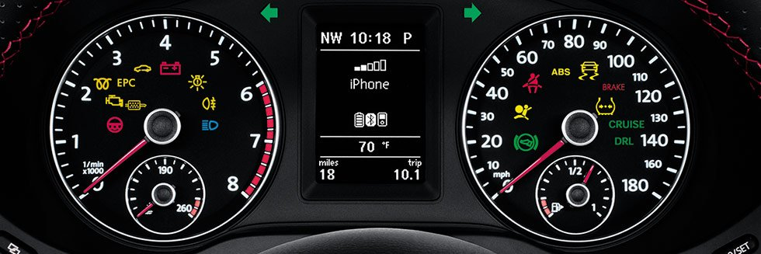
Exercise – what do you learn from looking at this car dashboard?

Slide 38
Performance measures are meaningful quantitative evidence used to monitor and track progress towards achievement of desired results
An indicator describes the environment in which you operate, including external factors that impact services
Measures are controllable, indicators are not (usually)

Slide 39
Types of performance measures
Input
Output
Outcome
Indicators
Efficiency
Effectiveness
Quality
Conditions
Cost-Effectiveness

Slide 40
Input
Amount of resources used (or available)
to provide services
Examples:
Employees or full-time equivalents (FTEs) hours/2,080
Expenditures for library materials
Number of sworn firefighters
Hours paid to sworn police personnel
Physical resources used– electricity, water, gas, steel, cement, asphalt
What’s an input in your area?

Slide 41
Output
Amount of work produced
or services delivered
Examples:
Tons of residential refuse collected
Number of lane miles swept
Number of applications processed
Number of sets of city council minutes prepared
Number of arrests
Number of trees planted
What’s an output for your area?

Slide 42
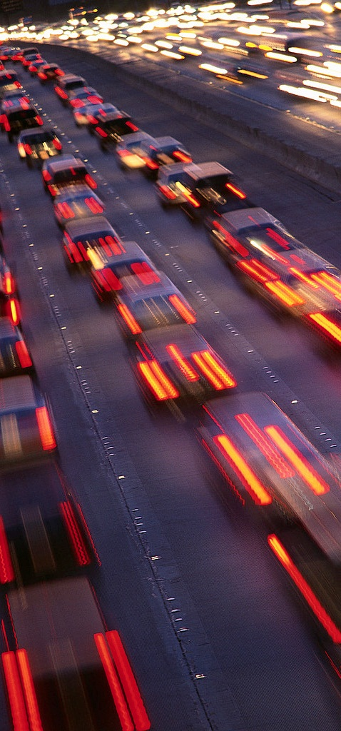
Outcome
The desired end result that demonstrates the impact of the services delivered
Examples:
City facilities are clean, well-maintained and open
Streets and roads are well-maintained and clean
Travel/transit times are reasonable & predictable
Identify outcomes clearly so you can identify the measureable factors that will get you the results you desire
What’s an outcome for your area?

Slide 43
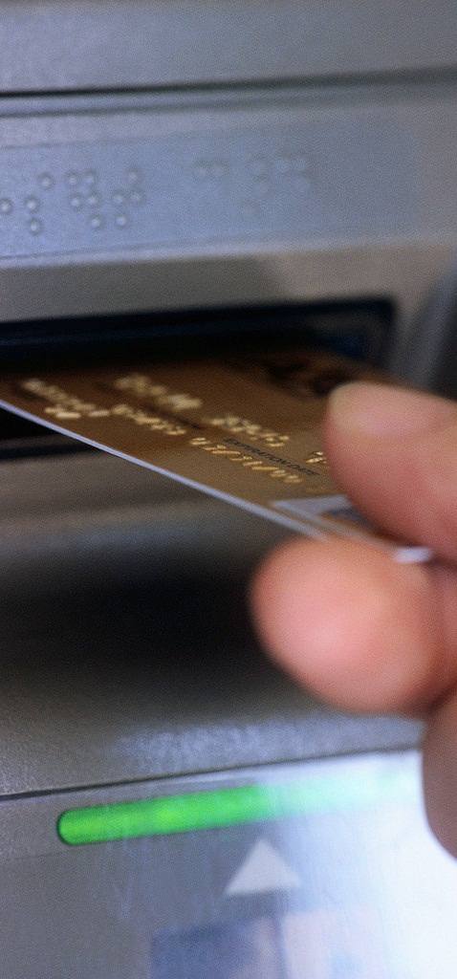
Efficiency
Amount of work done
per amount of resources used
Examples:
Number of transactions per FTE
Cost per work order completed
Expenditures per case closed
Road rehab expenditures per lane mile
What’s one way to measure efficiency in your area?

Slide 44
Effectiveness
Amount of achieved results, or the level of quality relative to amount of work done
Examples:
Citizen, employee and customer satisfaction, quality and timeliness ratings from surveys
Pavement condition index (PCI)
% of improperly repaired meters
% of cardiac arrest patients delivered with a pulse
Fire confined to room of origin
Thinking about your key outcomes, what’s one way to measure effectiveness in your area?

Slide 45
Quality
Quality work or services provided
per amount of resources used
Results achieved compared to a standard of acceptability or norm.
Calculated by dividing an efficiency (or input) measure by an effectiveness measure
Examples:
Percent of 9-1-1 calls dispatched within 30 seconds
Cost per properly repaired meter
Cost per vacancy filled successfully
% repaired within 24 hours
How might you measure quality work or services in your area?

Slide 46
Cost-Effectiveness
Amount of outcome achieved
per amount of resources used
Examples:
Per customer cost to provide after-school programs
Cost to provide 24-hour turnaround service on all building inspections
Per customer cost to provide passport services
Per customer cost for twice-weekly refuse and recycling collection
Per customer cost to provide neighborhood trolley services
How might you measure cost-effectiveness in your area?

Slide 47
Types of performance measures
Input
Amount of resources used (or available) to provide services
Output
Amount of work produced or services delivered
Outcome
The desired end result that demonstrates the impact of the services delivered
Indicators
Describe the environment in which the service is provided
Efficiency
Amount of work done per amount of resources used
Effectiveness
Amount of achieved results, or the level of quality relative to the amount of work done
Quality
Amount of quality work done per amount of resources used
Conditions
External requirements or demands that impact service delivery
Cost-Effectiveness
Amount of outcome achieved per amount of resources used

Slide 48
Questions performance measures can help answer
Input
How much resources (staff/$$$, etc.) did you use?
Output
How much work was accomplished?
Outcome
What are the desired results (short-term or long-term)?
Indicators
How large is your service area? What population and demographics do you serve?
Efficiency
How much work was accomplished with available resources?
Effectiveness
How well did you achieve the desired results?
Quality
How much time/effort was expended on quality work?
Conditions
What legal or regulatory requirements impact how you provide service?
Cost-Effectiveness
How much value was provided per dollar spent?

Slide 49
Solid Waste Example
Input
Equipment Operators
Output
Tons collected per month
Outcome
Refuse is collected in a reliable and clean manner
Indicators
Number of households
Efficiency
Tons collected per month per operator
Effectiveness
Tons collected per month without complaints of missed or messy collection
Quality
Tons of complaint-free collection per operator
Conditions
State law requiring twice per week pick-up
Cost-Effectiveness
Cost to provide residential refuse collection services per operator

Slide 50
Street Operations Example
Input
Staff
Output
Signals Repaired
Outcome
Signs and signals function correctly and are in good working order
Indicators
Number of Signals
Efficiency
Repairs per staff member
Effectiveness
Proactive repairs as a percent of total repairs or
Hours signals are out of service
Quality
Proactive repairs
per staff member
Conditions
MUTCD Requirements
Cost-Effectiveness
Operating and maintenance cost per signal

Slide 51
Fleet Maintenance Example
Input
Technician Hours
Output
Vehicle Repairs
Outcome
Timely and complete vehicle repairs
Indicators
Number of Vehicles
Efficiency
Repairs per Technician Hour
Effectiveness
% of vehicles repaired within 1 day; % of vehicles still working properly 6 months after repair
Quality
Time per properly repaired vehicle per technician
Conditions
ADEQ Requirements
Cost-Effectiveness
Operation and Maintenance Cost per Vehicle

Slide 52
Human Services Example
Input
Staff (FTEs)
Output
Hours of Meetings
with Clients
Outcome
Clients are self-sufficient and living independently
Indicators
Population at Low-Income Levels
Efficiency
Hours of Meetings with Eligible Clients per FTE
Effectiveness
Number of clients reporting improved financial condition
Quality
Clients reporting improved financial condition per FTE
Conditions
DES Requirements
Cost-Effectiveness
Per Client cost to provide case management services

Slide 53
Parks and Recreation Example
Input
Staff, Fields,
Instructors, $$$,
Contract Hours
Output
# of Classes
# of Participants
Outcome
Kids participate in organized physical activity and improve their health and wellness
Indicators
Total number of residents in target age group
Efficiency
Cost per class;
Cost per participants
Participants per instructor
Effectiveness
% willing to participate again; % rating excellent or good; Seats filled vs. seats available
Quality
Direct instruction as a % of total program hours; Hours utilized vs. hours available
Conditions
Liability insurance; CPS reporting; Classes offered by others
Cost-Effectiveness
Cost to provide class vs. cost charged to customer;
Cost per filled seat

Slide 54
Library Example
Input
Staff, Budget, Computers, Library Square Footage
Output
Borrowers, Items, Circulation
Outcome
Well-maintained , well-equipped facilities with desirable resources for use in lifelong learning.
Indicators
Residents
Efficiency
Circulated items per borrower
Effectiveness
% rating library services as “excellent” or “good;”
% rating they could find what they were looking for
Quality
Cost per circulated item (fiction, non-fiction, electronic, etc.)
Conditions
Inter-Library Loan linked to LSTA Funding
Cost-Effectiveness
Cost for library services per resident, or per borrower

Slide 55
Human Resources Example
Input
Recruitment & Selection Expenses, Recruitment Staff Hours
Output
Recruitments Conducted
Outcome
Vacancies are filled timely & successfully to minimize service disruption
Indicators
Authorized FTEs
Efficiency
Cost per vacancy filled; Time per vacancy filled
Effectiveness
New hires successfully completing probation and performing satisfactorily 6 monThs later
Quality
Cost per vacancy filled successfully
Conditions
EEOC, ADA, etc.
Cost-Effectiveness
Cost to provide recruitment and selection services

Slide 56
Police Example
Input
Police Officers
Output
Arrests
Outcome
Provide a safe city through arresting offenders and bringing them to justice
Indicators
Reported Crimes
Efficiency
Arrests per officer
Effectiveness
Clearance rate
Quality
Clearance rate per officer
Conditions
State statutes; Case law;
Legal evidence requirements
Cost-Effectiveness
Cost per cleared case

Slide 57
Police Example
Input
Officers; Training;
Vehicles; Technology
Output
Citations Issued
Outcome
Discourage high speeds and avoid collisions
Indicators
Traffic volume
Efficiency
Citations issued per hour of active enforcement
Effectiveness
Compliance rate (+);
Collision rate (-);
Citizen satisfaction with traffic enforcement
Quality
Compliance Rate per hour of active enforcement
Conditions
Laws regulating traffic enforcement; legal evidence requirements
Cost-Effectiveness
Cost per hour of
active enforcement

Slide 58
Are you staying with me? Any questions?

Slide 59
Exercise - Measures
Input
Output
Outcome
Indicators
Efficiency
Effectiveness
Quality
Conditions
Cost Effectiveness

Slide 60
Exercise – Use Model to Identify Measures
WE ACHIEVE RESULTS
THAT BENEFIT CUSTOMERS
BY DELIVERING SERVICES
BY CONDUCTING ACTIVITIES
THAT USE RESOURCES

Slide 61
1
2
3
5
6
4
7
8
10
11
9
12

Slide 62
62
Your palette should be:
relevant understandable complete

Slide 63
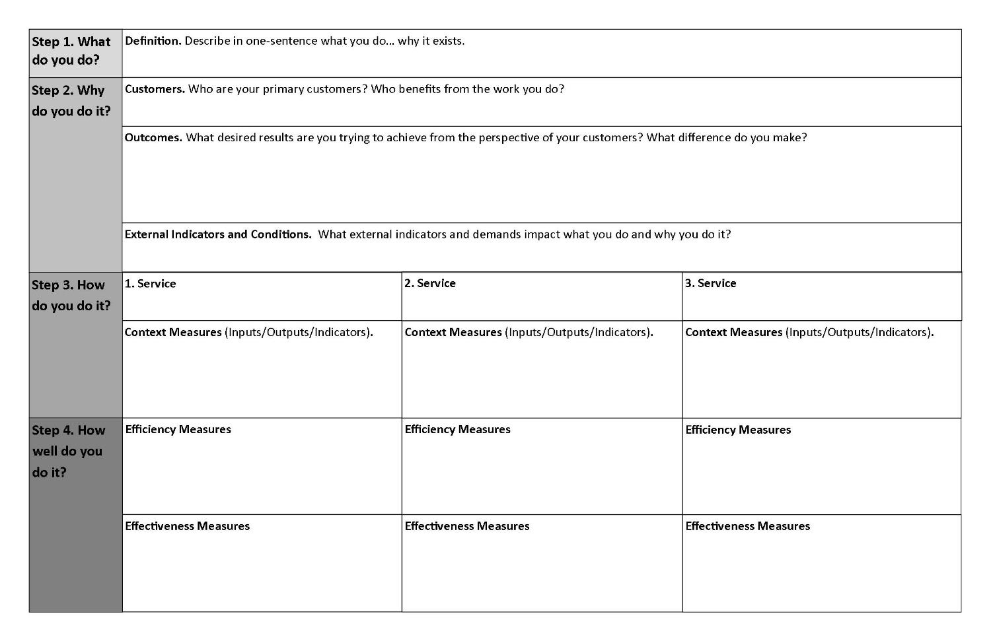

Slide 64
How to develop a consistent and intelligent approach to measuring the performance of your work unit

Slide 65
Today’s Goal:
develop a consistent and intelligent method to measuring performance in your department and
identify a set of initial measures to track efficiency and effectiveness of your department

Slide 66
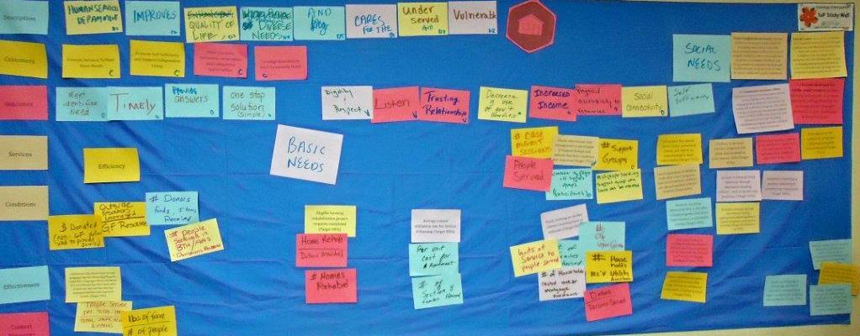
1. What do you do? Describing your purpose
2. Why do you do it? Identifying outcomes
3. How do you do it? Counting inputs and outputs
4. How well do you do it? Measuring efficiency & effectiveness
5. Can you explain it to others?

Slide 67
Review the description of your area
Does this accurately respond to the question -
Why does your department exist?

Slide 68
Who are your customers?
Write down one customer that you serve
A customer is an actual or potential user of your organization’s products, programs or services.
Can be direct, or indirect

Slide 69
What desired results are you trying to achieve?
Write down a desired result (outcome) that your organization is striving to achieve from the perspective of each customer.
Desired results describe the ultimate benefit to your customers from the work you do

Slide 70
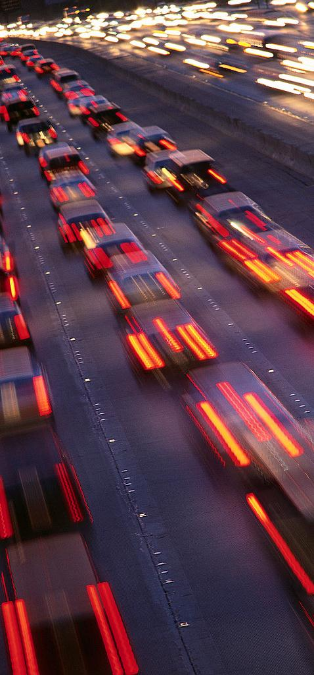
What services do you provide?
These are the significant services your department provides.

Slide 71
What are your top priority services?
Consider these questions in selecting your top three priority services
Which service benefits the most customers?
Which service can only be received from your organization?
Which service uses the most resources ($$$, time, staff)?
Which service is most closely identified with your organizational unit?

Slide 72
What external indicators or conditions impact how you provide services?
Includes such things as:
Legal requirements
Government regulations
Number and types of customers/calls for service
What external requirements or demands impact what you do and why you do it?

Slide 73
Developing measures
What resources (inputs) do you have available?
What activities (outputs) do you perform?
Thinking about your outcomes, which activities most impact your outcome?

Slide 74
Efficiency / Effectiveness
How can you best measure the efficiency of your area?
How can you best measure the effectiveness of your area?
Thinking back to your description, which combinations of measures lead to the best overall snapshot of performance in your area?

Slide 75
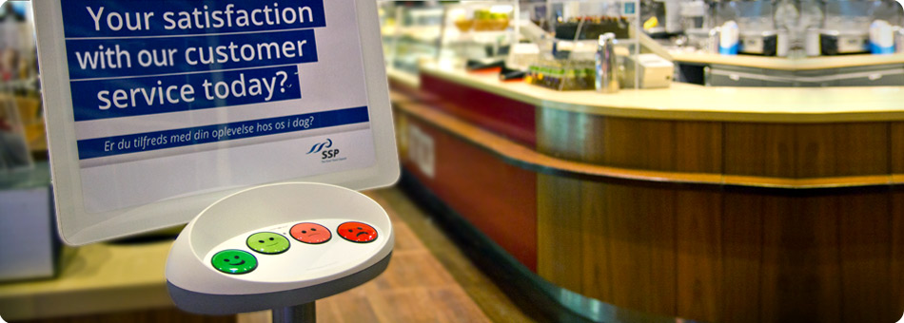
Some ways to measure effectiveness

Slide 76
Restroom Cleanliness Evaluation |  |  |  | Date: / / /
Check Points | Wt | Score % | Wted Score % | RR #: _______
Toilets/urinals clean | 25 | 85% | 21% | Inspected by:
Sinks clean | 15 | 90% | 14%
Floor clean | 10 | 50% | 5%
Mirror clean | 10 | 100% | 10%
Paper products in place | 25 | 80% | 20%
No trash on floors/counters | 15 | 100% | 15%
Totals | 100 |  | 85%
Notes:
1. Criteria must be designed and used for evaluating each Check Point. The inspector fills in a score for each Check Point (in blue above).
2. The weighted score for each Check Point is found by multiplying the [Wt X Score %] (in red above). The Total Weighted Score % provides a measure of the restroom cleanliness based on the weighted scores of each Check Point.
3. Scores can be compared by dates to assess trends (up or down).
4. Scores may also be compared for different restrooms.
5. This method is useful for establishing a measure for elements that are subjective, i.e., a matter of judgment.

Slide 77
Review your proposed measures through three filters to determine it’s a consistent and intelligent approach. 1. From your customers perspective 2. From the organization’s perspective (management and employees) 3. From the City Council’s perspective Is this relevant, understandable and complete? If not, what changes are needed?
Does this make sense to others?

Slide 78
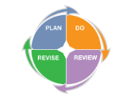
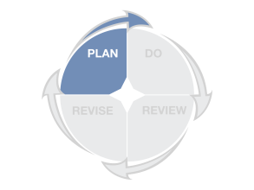
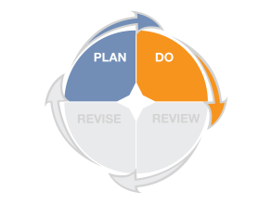
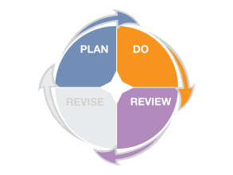
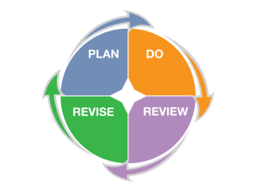
What are we asking you to do?
1. Review services to ensure they are linked to the strategic and/or general plan goals, and make adjustments as needed
2. Review existing measures to ensure you are measuring the efficiency, effectiveness, and cost-effectiveness of services and create new measures, if needed
3. Identify standards and targets for each measure to ensure that you have context for evaluating success
4. When measures do not meet identified targets or standards, develop objectives, initiatives and measures to improve performance

Slide 79
Finding the best (available) outcome measures

Slide 80
Output (Activities) |  | Outcome (Results)
Permits provided | Is not the same as | Businesses operating within code
Miles of road paved | Is not the same as | Safe driving conditions
Students receiving training | Is not the same as | Students acquire knowledge/skills

Slide 81
Which of the following is the best example of a measure for the outcome of “Customers are loyal to our coffee shop.”
Repeat visitors – Percent of customers who indicated they visit our coffee shop more frequently than other coffee shops in the city, from a random monthly survey
Implement customer loyalty rewards program by December 2014
Customer share of wallet – the average across all our customers of the percentage of their expenses for coffee that is spent with our coffee shop, from a monthly random sample of customers.
Product awareness – percentage of local coffee drinkers who are aware of our coffee shop.
Customer loyalty—Number of members in our customer loyalty program

Slide 82
An outcome measure is… a comparison that provides objective evidence of the degree to which a performance result is occurring over time. Stacey Barr

Slide 83
Decide what you’re trying to accomplish
Ask yourself these two questions:
How will you know whether or not you’re making progress?
How will you persuade someone else you’re right?
From Robert Lewis. 2009. “No metrics? Don’t fret; you can still manage without measuring.” Minneapolis St. Paul Business Journal.

Slide 84
You’re in
LUCK!

Slide 85
ASSESS
RESULTS

Slide 86
Targets express a specific level of performance the organization is aiming to achieve.

Slide 87
Standards (also called “benchmarks”) express the minimum acceptable level of performance that is expected and achieved by other, high-performing organizations.

Slide 88
“Hello, this is Tech Support.
May I close your ticket now?”

Slide 89
“The key
is always
to measure
the right things.”
Patrick Lencioni

Slide 90
Target setting

Slide 91
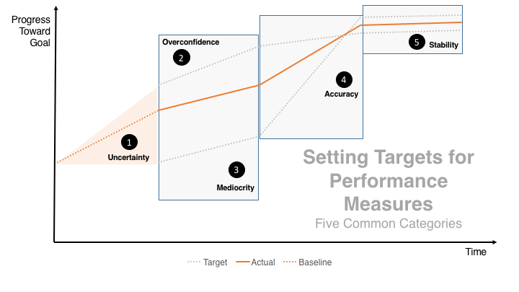
https://centerforgov.gitbooks.io/setting-performance-targets-getting-started-guide/content/

Slide 92
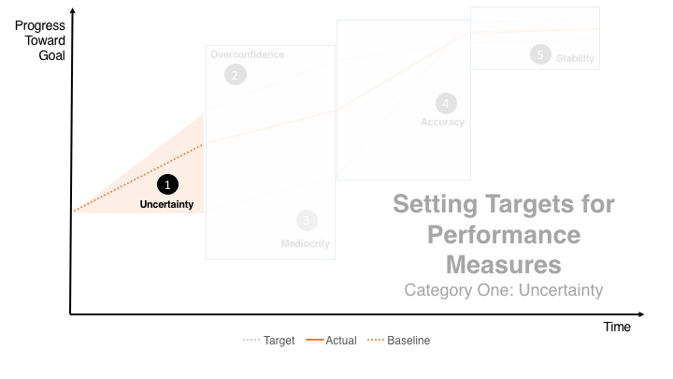

Slide 93
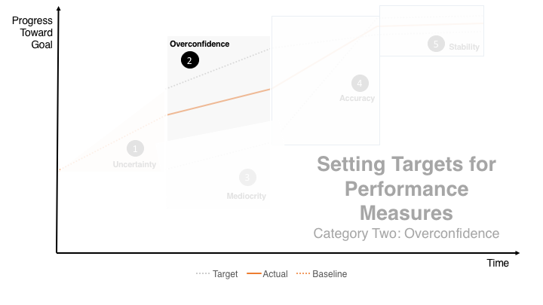

Slide 94
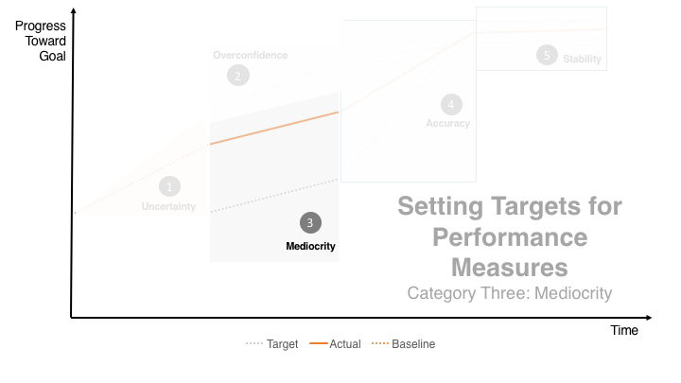

Slide 95
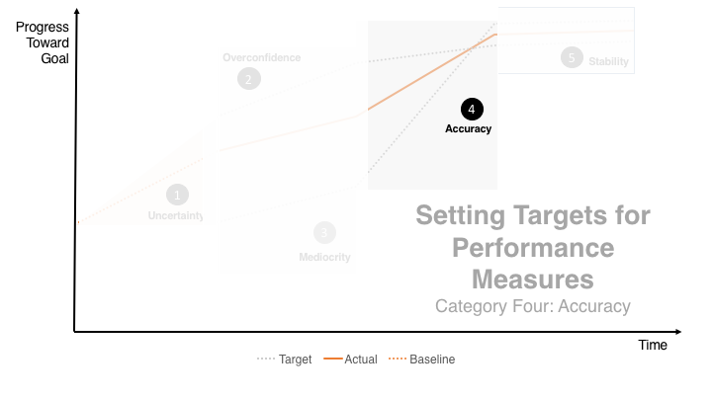

Slide 96
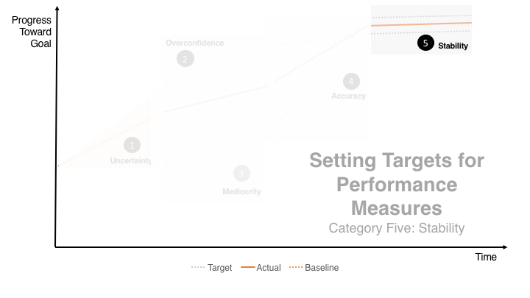

Slide 97
Benchmarking

Slide 98
Comparing performance with other organizations

Slide 99
Why compare? It’s human nature
We compare for context
We compare for validation
We compare to track progress
We compare for motivation
We compare to understand

Slide 100
The key question should be:
“Compared to what?”

Slide 101
What you don’t know
You don’t know what you don’t know
Have no explanation for variation
Reasons why you got the results
Reliability / validity of data

Slide 102
How networks can help
Discussions to gain understanding
Identify best practices and improve the services we provide
Track progress and trends
Improve accuracy

Slide 105
Permitting expenditures per permit (in $)

Slide 106
Permitting expenditures per permit (in $)

Slide 107
Permitting expenditures per permit (in $)

Slide 108
Permitting expenditures per permit (in $)

Slide 109
Property Crime Clearance Rates
Glendale: Clearance Rates include cases “Cleared by Arrest” or “Submitted to Prosecutor” and cases “Cleared Exceptional”
Tempe: Tracks “Adult” and “Juvenile” clearance rates, reporting aggregate rate. Arson data is unavailable and not included in
property crime totals.
A clearance rate is calculated by dividing the number of crimes that are “cleared” via a charge being assessed by the total number of
crimes recorded in a given year. Considering the special complexity of some cases, some charges will be included outside of the
year when the crime occurred.
14

Slide 110
“Evidence suggests that improved performance
occurs at a much greater rate when
performance measures are compared.”
Smith and Cheng, 2004

Slide 111
Analyzing Measures in Context:
Using Charts and Graphs

Slide 112
Exercise

Slide 113
Why did it happen?
Questions for evaluation:
What happened?
How did it happen?
Was this the most efficient use of resources?
How effective was the effort?
How can we improve on the result?

Slide 114
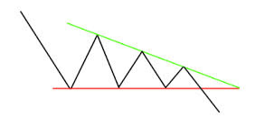
With performance measures: look for patterns, not points

Slide 115
Measure

Slide 116
Measure

Slide 117
Measure

Slide 118
Target or Standard
Measure

Slide 119
Target or Standard
Measure

Slide 121
2015 Average
2016 Average
2015
2016

Slide 122
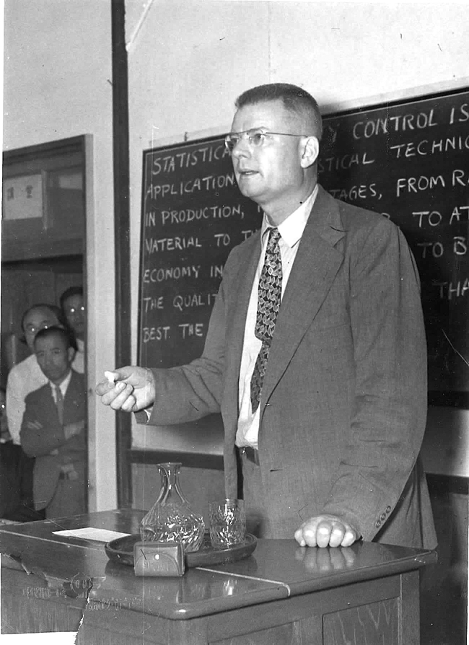
“We must understand variation.”
(avoid management tampering)
Dr. W. Edwards Deming

Slide 123
“The signal is the truth.
The noise is what distracts us from the truth.”
Nate Silver

Slide 124
Seven important performance signals
# 1 Unpredictable or chaotic
# 2 Worsening
# 3 Stable and not changing
# 4 Improving, but not fast enough
# 5 Improving at a rate fast enough
# 6 Reached target
# 7 Exceeded the target

Slide 125
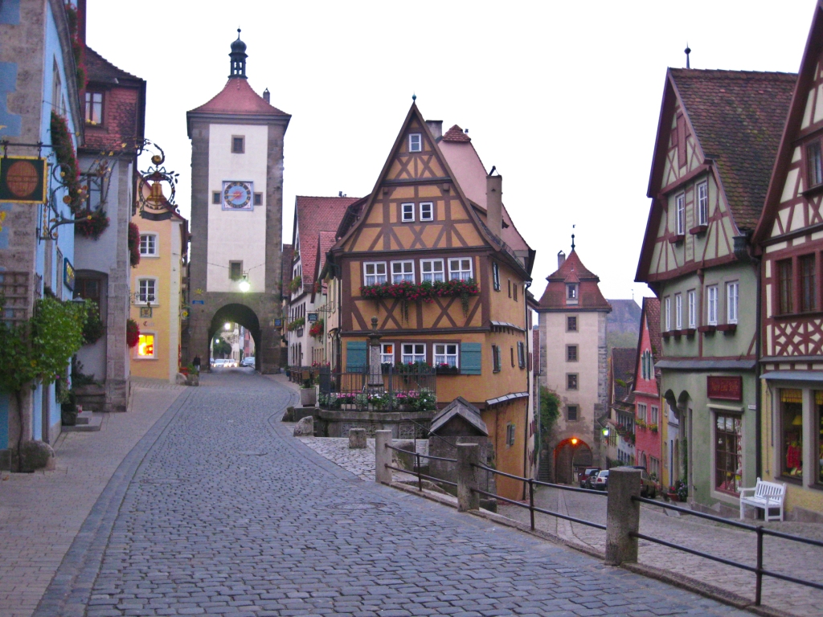
Data validation
“But you must never forget that every one of these figures comes from the village watchman, who just puts down what he damn well pleases.” Sir Josiah Stamp, 1911

Slide 126
Talking about Performance The performance dialogue process
INITIATE
Participants first seeing the data and attempting to understand and to identify signals
INTEGRATE
Sharing interpretations of the data with each other
SEARCH
Additional information and data gathering (if necessary) to find causes
DECIDE
Identify solutions and determine activities to put the chosen solution into practice

Slide 127
Basic principles of “stats” programs
Accurate and timely intelligence
Rapid deployment of resources
Effective tactics
Relentless follow-up and assessment

Slide 128
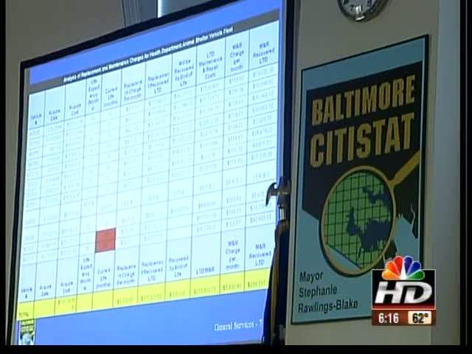
Tips for successful Performance Review Sessions:
Leadership sufficiently interested to support and participate in regular meetings
A process that provides timely and accurate data on program outputs and outcomes
Staff that can assist the leader in examining the data and provide advice on issues to address at the meetings

Slide 129
DATA
USING
REPORT
TO
HOW

Slide 130
“…the public feels strongly
that government has a responsibility to provide understandable financial information to the public.”
Harris Interactive Survey (2010)

Slide 131
clutter

Slide 132
clarity

Slide 133
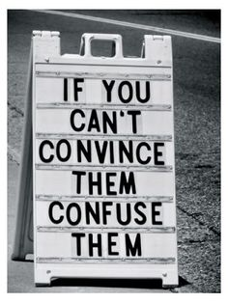

Slide 134
The three principles of simplicity

Slide 135
Empathize
Perceive others needs & expectations

Slide 136
BEGINNING
OF TIME
2003
FIVE BILLION GIGABYTES
WEDNESDAY
FRIDAY

Slide 137
40
hours
640,000
words
1,600
pages
25
reports

Slide 138
what
you want
to say
what
they need
to hear

Slide 139
Empathize
Perceive others needs & expectations
Distill
Boil down & customize to meet needs

Slide 140
You are a curator.

Slide 141
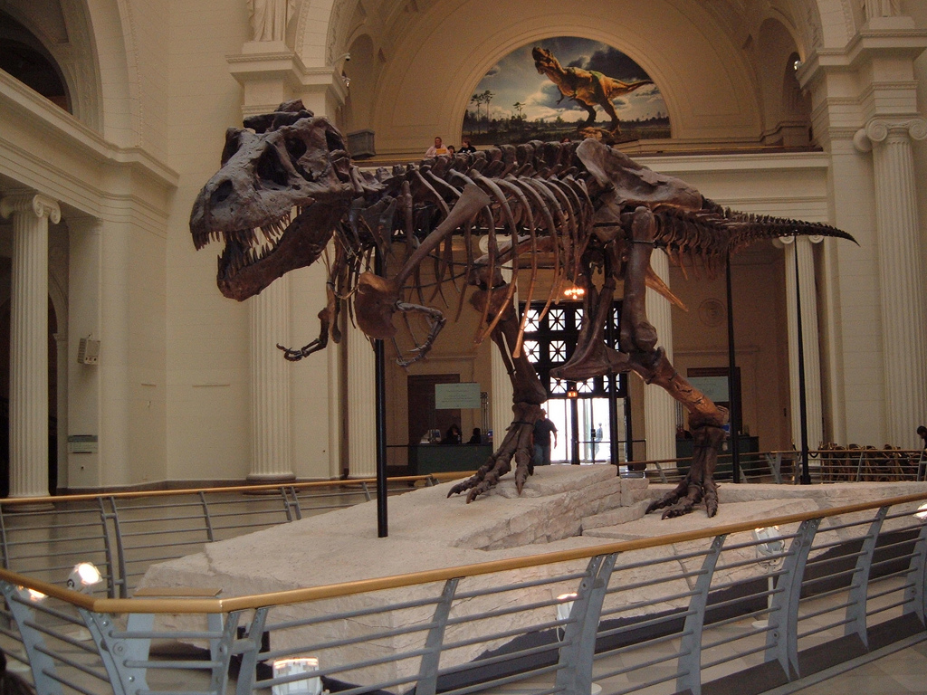
Don’t hide the T-Rex.

Slide 142
Empathize
Perceive others needs & expectations
Clarify
Make it easier to understand
& use
Distill
Boil down & customize to meet needs

Slide 143
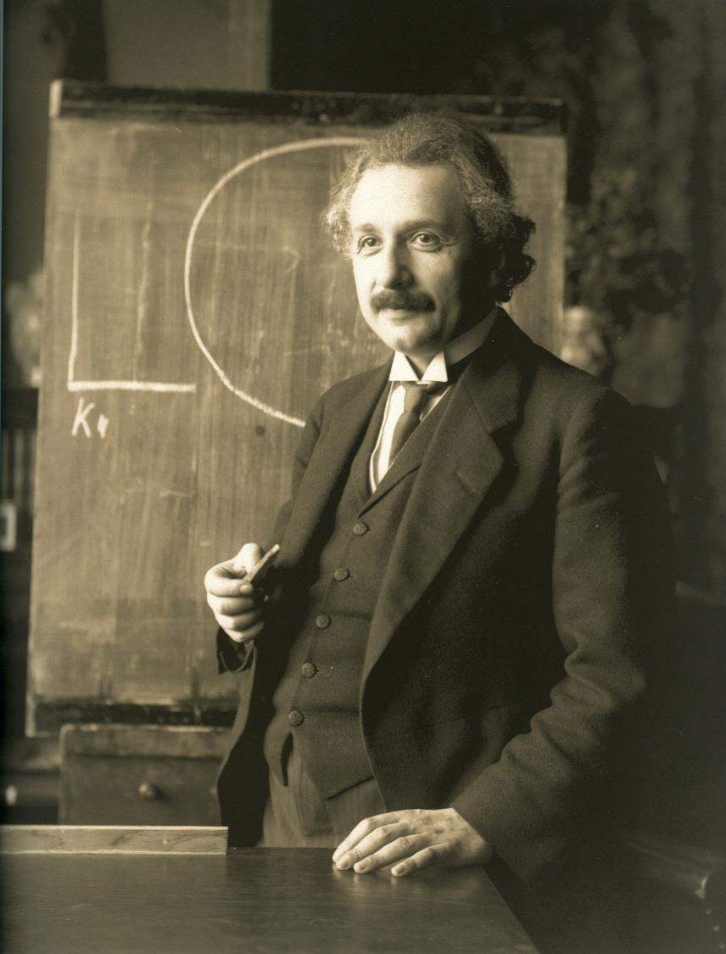
Everything should be made as simple as possible but no simpler.
“It can scarcely be denied that the supreme goal of all theory is to make the irreducible basic elements as simple and as few as possible without having to surrender the adequate representation of a single datum of experience.”
from “On the Method of Theoretical Physics.”
Albert Einstein (1933)

Slide 144
Empathize
Perceive others needs & expectations
simplicity
Clarify
Make it easier to understand
& use
Distill
Boil down & customize to meet needs
From: “Simple: Conquering the Crisis of Complexity,” Alan Siegel and Irene Etzkorn (2013)

Slide 145
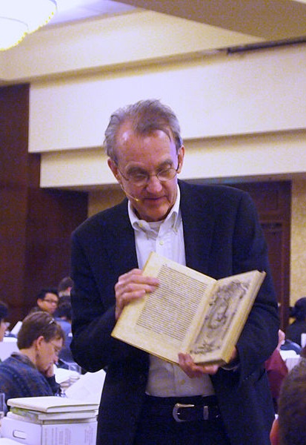
Edward R. Tufte
The Visual Display of Quantitative Information, Edward R. Tufte, 2001
@EdwardTufte

Slide 146
Remove Chartjunk
“interior decoration of graphics generates a lot of ink that does not tell the viewer anything new.”

Slide 147
Increase Data-Ink
“data graphics should draw the viewer’s attention to the sense and substance of the data, not to something else.”

Slide 148
Accessible Complexity: Characteristics of the Friendly Data Graphic
words are spelled out
words run from left to right
little messages help explain data
avoid elaborately encoded shadings, crosshatching and colors
labels are placed on the graphic itself; no legend is required
graphic attracts viewer, provokes curiosity
colors, if used, are chosen so that color-deficient and color-blind (5 to 10 percent of viewers) can make sense of the graphic (blue can be distinguished from other colors by most color-deficient people)
Type is clear, precise, modest
Type is upper- and lower-case, with serifs
The Visual Display of Quantitative Information, Edward R. Tufte, 2001, p. 183

Slide 149
Perfection is finally attained not when there is no longer anything to add…
but when there is no longer anything to take away ...
Antoine de Saint Exupéry

Slide 150
“effective information visualization (is) premised on:
simplicity
(complex notions simplified to save time for reader);
transparency
(visual honesty and responsibility in sourcing);
creativity
(design that is memorable and understandable);
sociability
(easily shared and improved)”
@Sambrook
http://www.edelman.com/p/6-a-m/visualizing-information/

Slide 151
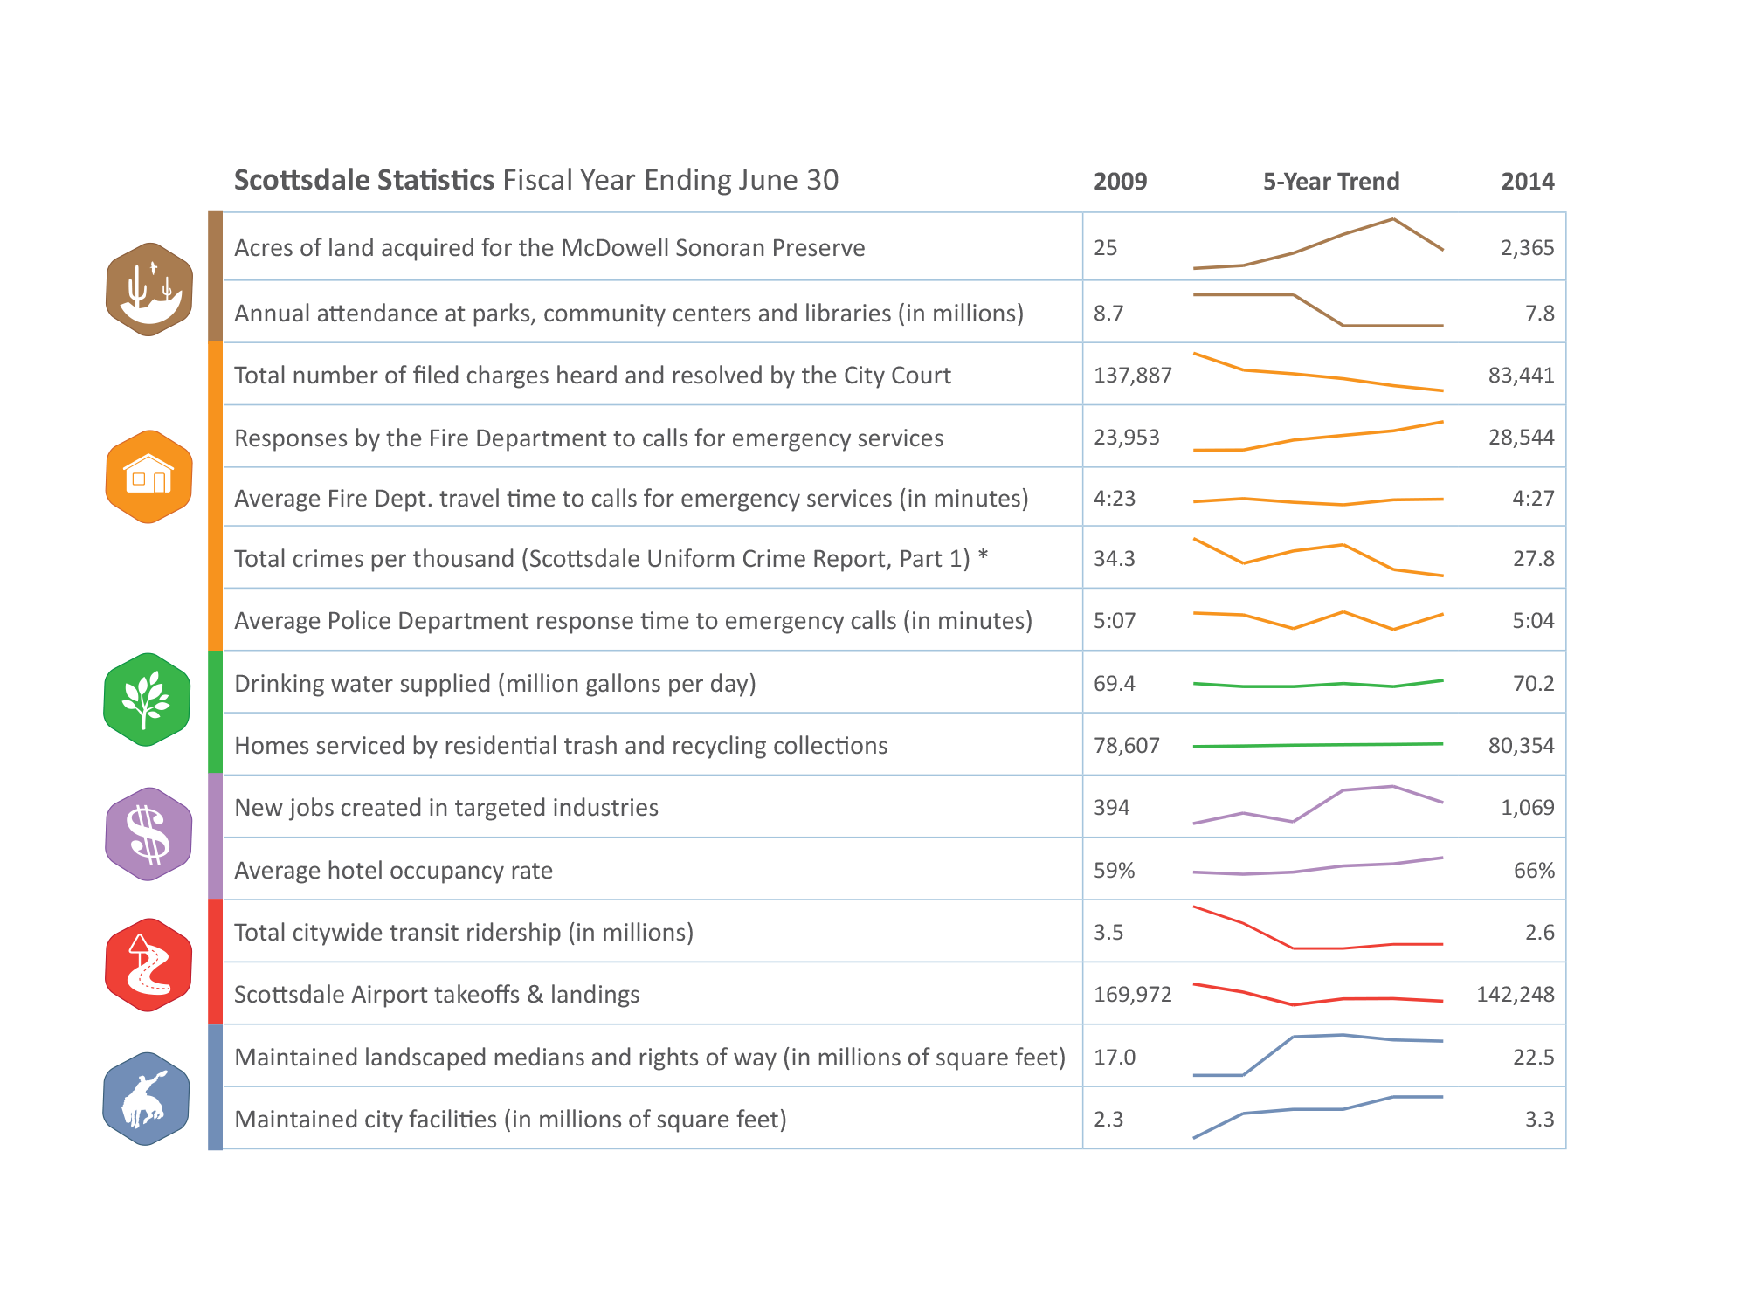
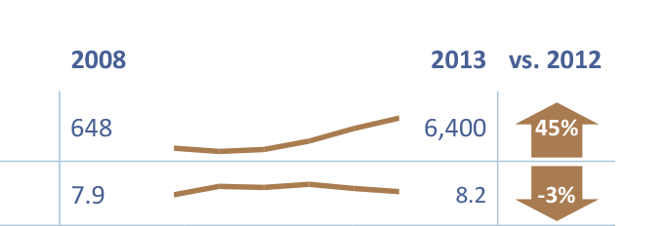
“effective information visualization (is) premised on:
simplicity
(complex notions simplified to save time for reader)

Slide 152
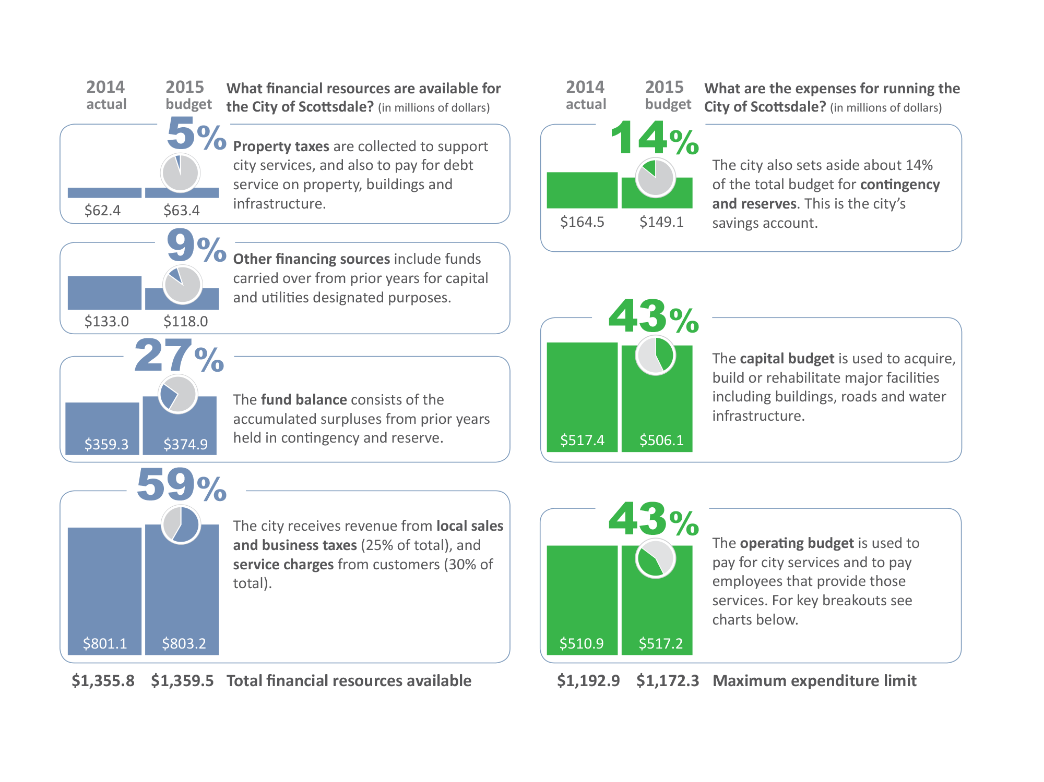
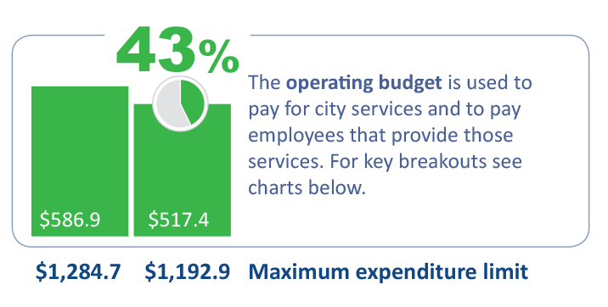
“effective information visualization (is) premised on:
transparency
(visual honesty and responsibility in sourcing)

Slide 153
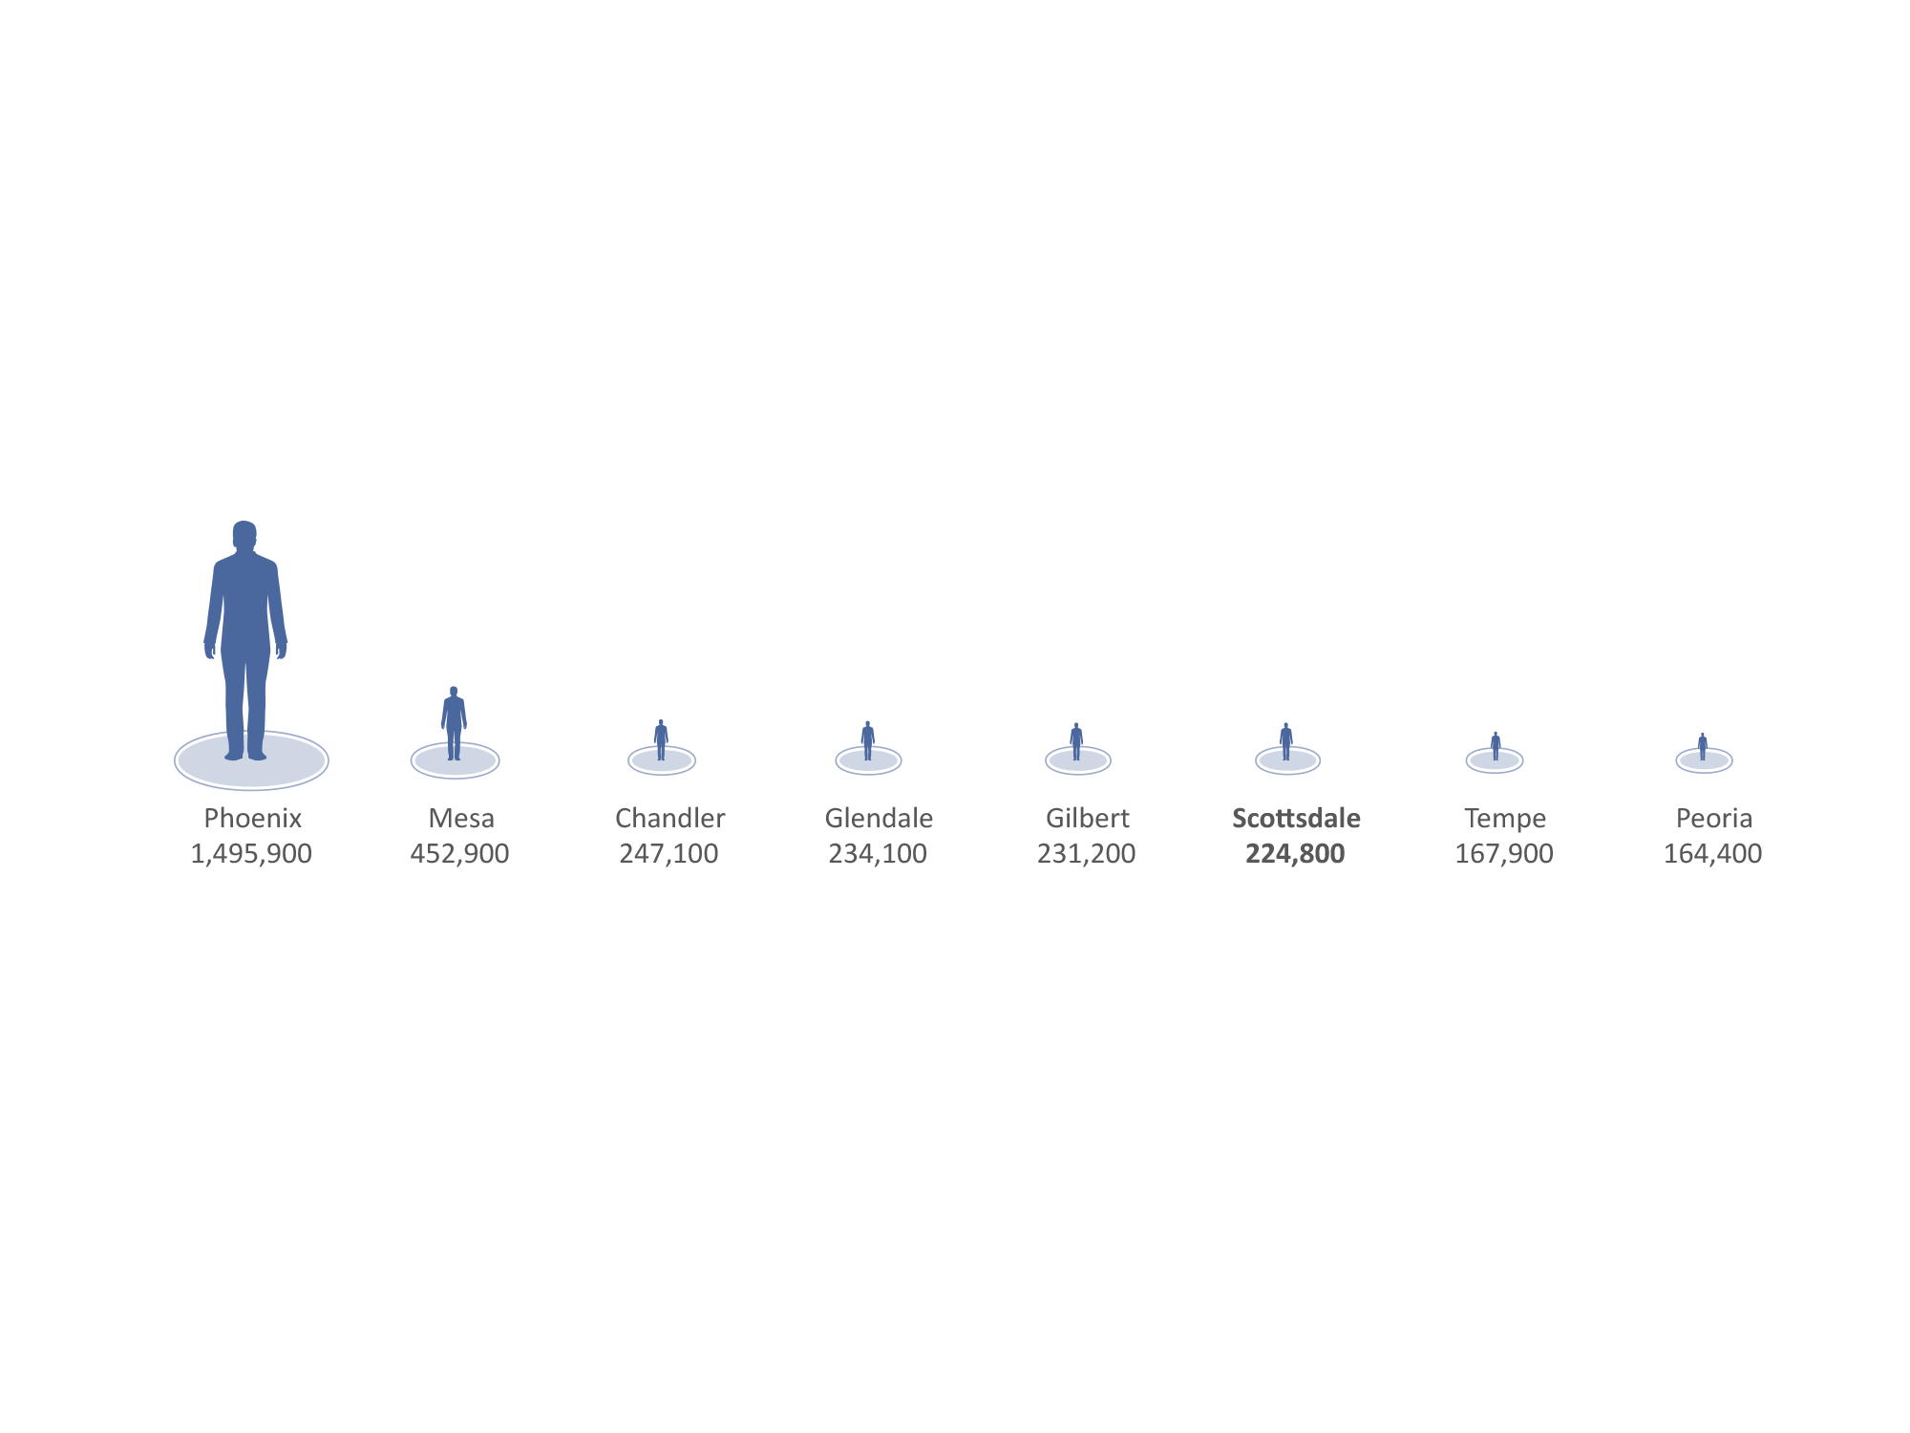
“effective information visualization (is) premised on:
creativity
(design that is memorable and understandable)
Phoenix is almost 7 times larger than Scottsdale!

Slide 154
“effective information visualization (is) premised on:
sociability
(easily shared and improved)

Slide 155
IMPROVE
RESULTS

Slide 156
Start with your data and reports

Slide 157
“Goals make it absolutely clear where you will concentrate resources for results – the mark of an organization serious about success.”
Peter Drucker

Slide 158
158
Goals:
Are overarching
Should be few in number (5 or less)
Flow from the mission
Build on strengths
Address opportunities
Collectively outline your desired future

Slide 159
Customer
Financial
Process
Growth

Slide 160
The basic formula for effective goals
a measure
a target
a timeframe

Slide 161
Land a man on the moon
and return him safely to earth
by the end of this decade

Slide 162
Land a man on the moon
and return him safely to earth
by the end of this decade

Slide 163
Land a man on the moon
and return him safely to earth
by the end of this decade

Slide 164
Land a man on the moon
And return him safely to earth
By the end of this decade

Slide 165
Said another way…
do this
to this level
by this time

Slide 166
Measuring success of effective goals
was it done? how do you know?
were the standards met? every time? to what degree?
was it done on time?

Slide 167
Complete work that is of high quality and free of errors.
Produce reports that are free from self-made errors (grammatical, factual, omissions) with no more than 10 reports containing errors in a fiscal year.
10 or less
error free documents
fiscal year

Slide 168
Enhance officer safety
Reduce the total number of officer accidents by 10 percent from previous year’s number by June 30
10% reduction
reduce accidents
fiscal year

Slide 169
Provide excellent customer service
Complete 80% of work orders classified non-emergency within 14 days of submission with a satisfaction score of “satisfactory” or above
number of completed work orders
80% completed within 14 days and with a score of “satisfactory” or above
within 14 days

Slide 171
Weasel Words
Activate, advance; assure; cultivate; efficient; effective; engage; enhance; enlighten; ensure; facilitate; implement; inspire; integrate; maintain; mitigate; monitor; optimize; productive; realize; responsiveness; revitalize; strengthen; strive; support; sustain; utilize

Slide 172
ACTION WORDS
achieve; apply; accelerate; allocate; assist; begin; build; complete; conduct; coordinate; create; deliver; design; develop; devise; establish; expand; extend; hire; hold; identify; improve; increase; invent; maintain; manage; maximize; meet; minimize; modify; produce; provide; reduce; supply; translate; use

Slide 173
Simply
better
service …
Meet 60 day target in 80% of assigned recruitments
(20 recruitments per employee)
Meet 60 day target in 80% of recruitments (assumes 100 recruitments with 5 employees)
High-performing organization and work culture
Achieve favorable timeliness rating of 75% for recruitment services
Human Resources
Staffing Services
Example
Organization
Division
Department
Center
Employees

Slide 174
Citywide Goals
50,000 feet
Division/Department/Center Goals and Objectives
10,000 feet
10,000 feet
Sea level
Employee Goals
Sea level

Slide 175
Citywide Goals
Includes both Strategic Goals (General Plan) and Council Priorities (Strategic Plan) Defines a specific area of concentration Outcome-oriented (either quantitative or qualitative) Flexibility in manner of meeting goal Often pertinent to more than one area Something you influence, not totally control
50,000 feet

Slide 176
Division/Department/Center Goals and Objectives
10,000 feet
Restatement of strategic or operational goal specifically relating to department
Oriented to measurable results or outcomes
Usually within department’s area of control
Goal achievement requires one or more SMART objectives and one or more initiatives
Objectives usually address the result of a process -- improve, reduce, cut, increase
Initiatives are managed as projects -- schedule milestones, cost, quality, completion date
10,000 feet

Slide 177
Employee Goals
Sea level
Direct control. A goal entirely under employee’s control
Indirect control. A goal partially under employee’s control but requires working with others, either inside or outside the organization, to accomplish the goal
Influenceable, but not controllable. A goal not under the employee’s control, typically addressing a major issue, or potential issue, that may be influenced through coordinated efforts.
As responsibility increases, goals typically move from Direct, to Indirect, to Influenceable, but not controllable
10,000 feet

Slide 178
What are you trying to achieve?
Who are you doing it for?
Questions that well-written goals answer
How will you contribute?
How will you measure progress?
Who is responsible?
When will you get there?

Slide 179
To enhance public safety
for all Scottsdale residents,
the Transportation Department
will increase bike lane miles
by 5%
by June 30.

Slide 180
What are you trying to achieve?
Who are you doing it for?
To enhance public safety
for all Scottsdale residents,
the Transportation Department
will increase bike lane miles
by 5%
by June 30.
How will you contribute?
How will you measure progress?
Who is responsible?
When will you get there?

Slide 182
“Don’t write so that you can be understood, write so that you can’t be misunderstood.”
President William Howard Taft

Slide 183
WRAP IT UP ALREADY!!!

Slide 184
Three reasons employees don’t like their jobs
From Patrick Lencioni. 2007. “The Three Signs of a Miserable Job.”
Anonymity
Irrelevance
Immeasurability
We aren’t understood or appreciated for our unique contribution
We don’t see how our work impacts the lives of others
We don’t get a daily sense of measurable accomplishment

Slide 185
Three reasons employees don’t like their jobs
From Patrick Lencioni. 2007. “The Three Signs of a Miserable Job.”
Anonymity
Irrelevance
Immeasurability
But, what if…
we understood our unique contribution,
knew how our work impacted others
and got a daily sense of accomplishment?
Wouldn’t that make a difference?

Slide 187
Learning and Growth
Innovation and Improvement
Accountability
and Transparency
Budgeting and
Decision-making

Slide 188
DEFINE
RESULTS
DEFINE
RESULTS
ACHIEVE
RESULTS
ACHIEVE
RESULTS
IMPROVE
RESULTS
IMPROVE
RESULTS
ASSESS
RESULTS
ASSESS
RESULTS

Slide 189
Start
with
Why
WHY
HOW
WHAT
Adapted from The Golden Circle, Simon Sinek, Start with Why

Slide 190
Mission
Why do we exist? What is our purpose?
Goals
What are our main focus areas to achieve the mission?
Objectives
What specific actions are needed to achieve the goals?
Initiatives
What specific projects are needed to achieve the objectives?
Measures
How will we know if we are achieving results?

Slide 191
Alignment Model
WE ACHIEVE RESULTS
THAT BENEFIT CUSTOMERS
BY DELIVERING SERVICES
BY CONDUCTING ACTIVITIES
THAT USE RESOURCES

Slide 192
Types of performance measures
Input
Output
Outcome
Indicators
Efficiency
Effectiveness
Quality
Conditions
Cost-Effectiveness

Slide 193
Empathize
Perceive others needs & expectations
simplicity
Clarify
Make it easier to understand
& use
Distill
Boil down & customize to meet needs
From: “Simple: Conquering the Crisis of Complexity,” Alan Siegel and Irene Etzkorn (2013)

Slide 194
The basic formula for effective goals
a measure
a target
a timeframe

Slide 195
What have you set out to accomplish?
Photo by Scott Amonson
M. Brent Stockwell | Asst. City Manager
480-312-7288 | Bstockwell@ScottsdaleAZ.gov
go to ScottsdaleAZ.gov search “about”

