Slide 1
Managing and measuring organizational performance
Brent Stockwell, Strategic Initiatives Director
Scottsdale City Manager’s Office
Bstockwell@ScottsdaleAZ.gov | 480-312-7288
www.ScottsdaleAZ.gov/departments/citymanager/performance

Slide 2
Measuring what matters
…improve results by
integrating objective evidence with decision-making processes
“What matters is not finding the perfect indicator, but settling upon a consistent and intelligent method of assessing your output results and then tracking your trajectory with rigor.”
“…rigorously assemble evidence – quantitative or qualitative –
to track your progress.”
Jim Collins. 2005. Good to Great and the Social Sectors.

Slide 3
Identified Best Practices
Visible Leadership
Reasonable Approach
Regular Reporting
Regular Review
Compare with others
Ask for feedback
Drives Resource Allocation/Rewards
Consistently Utilized
Strategically Aligned

Slide 4
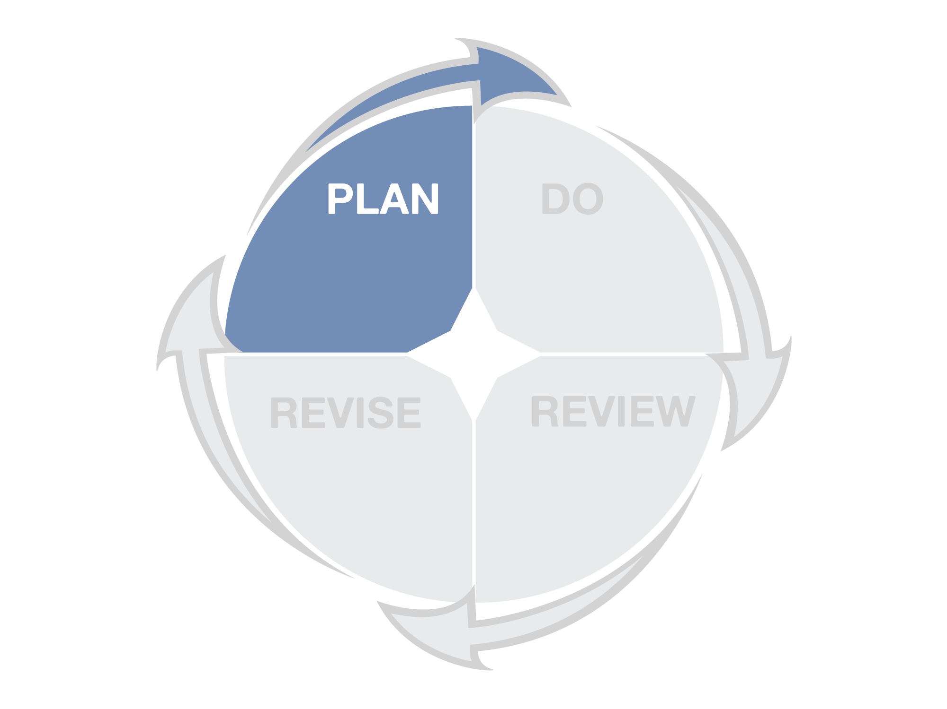
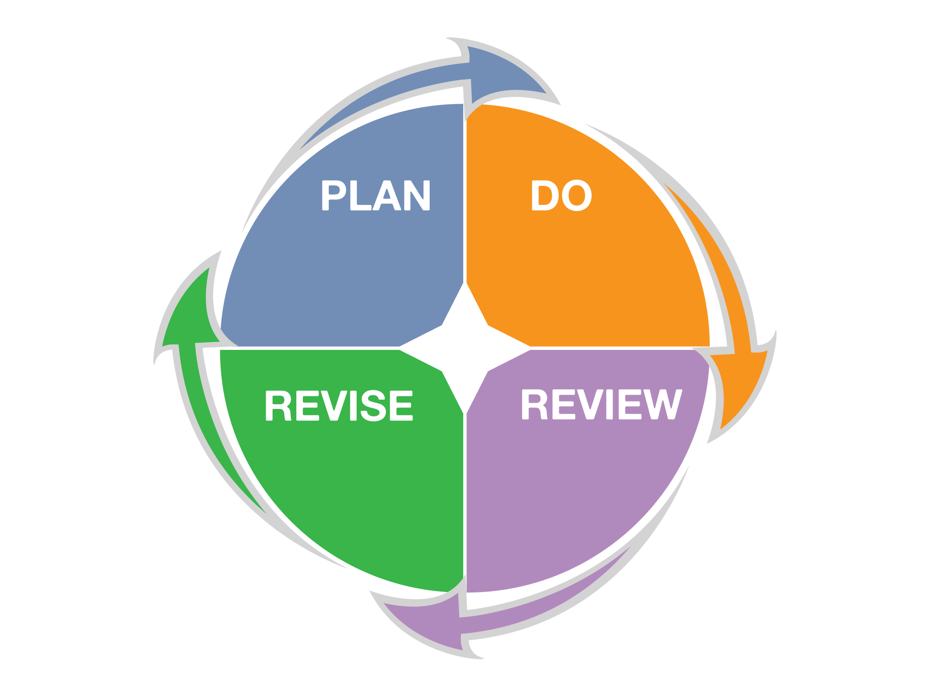
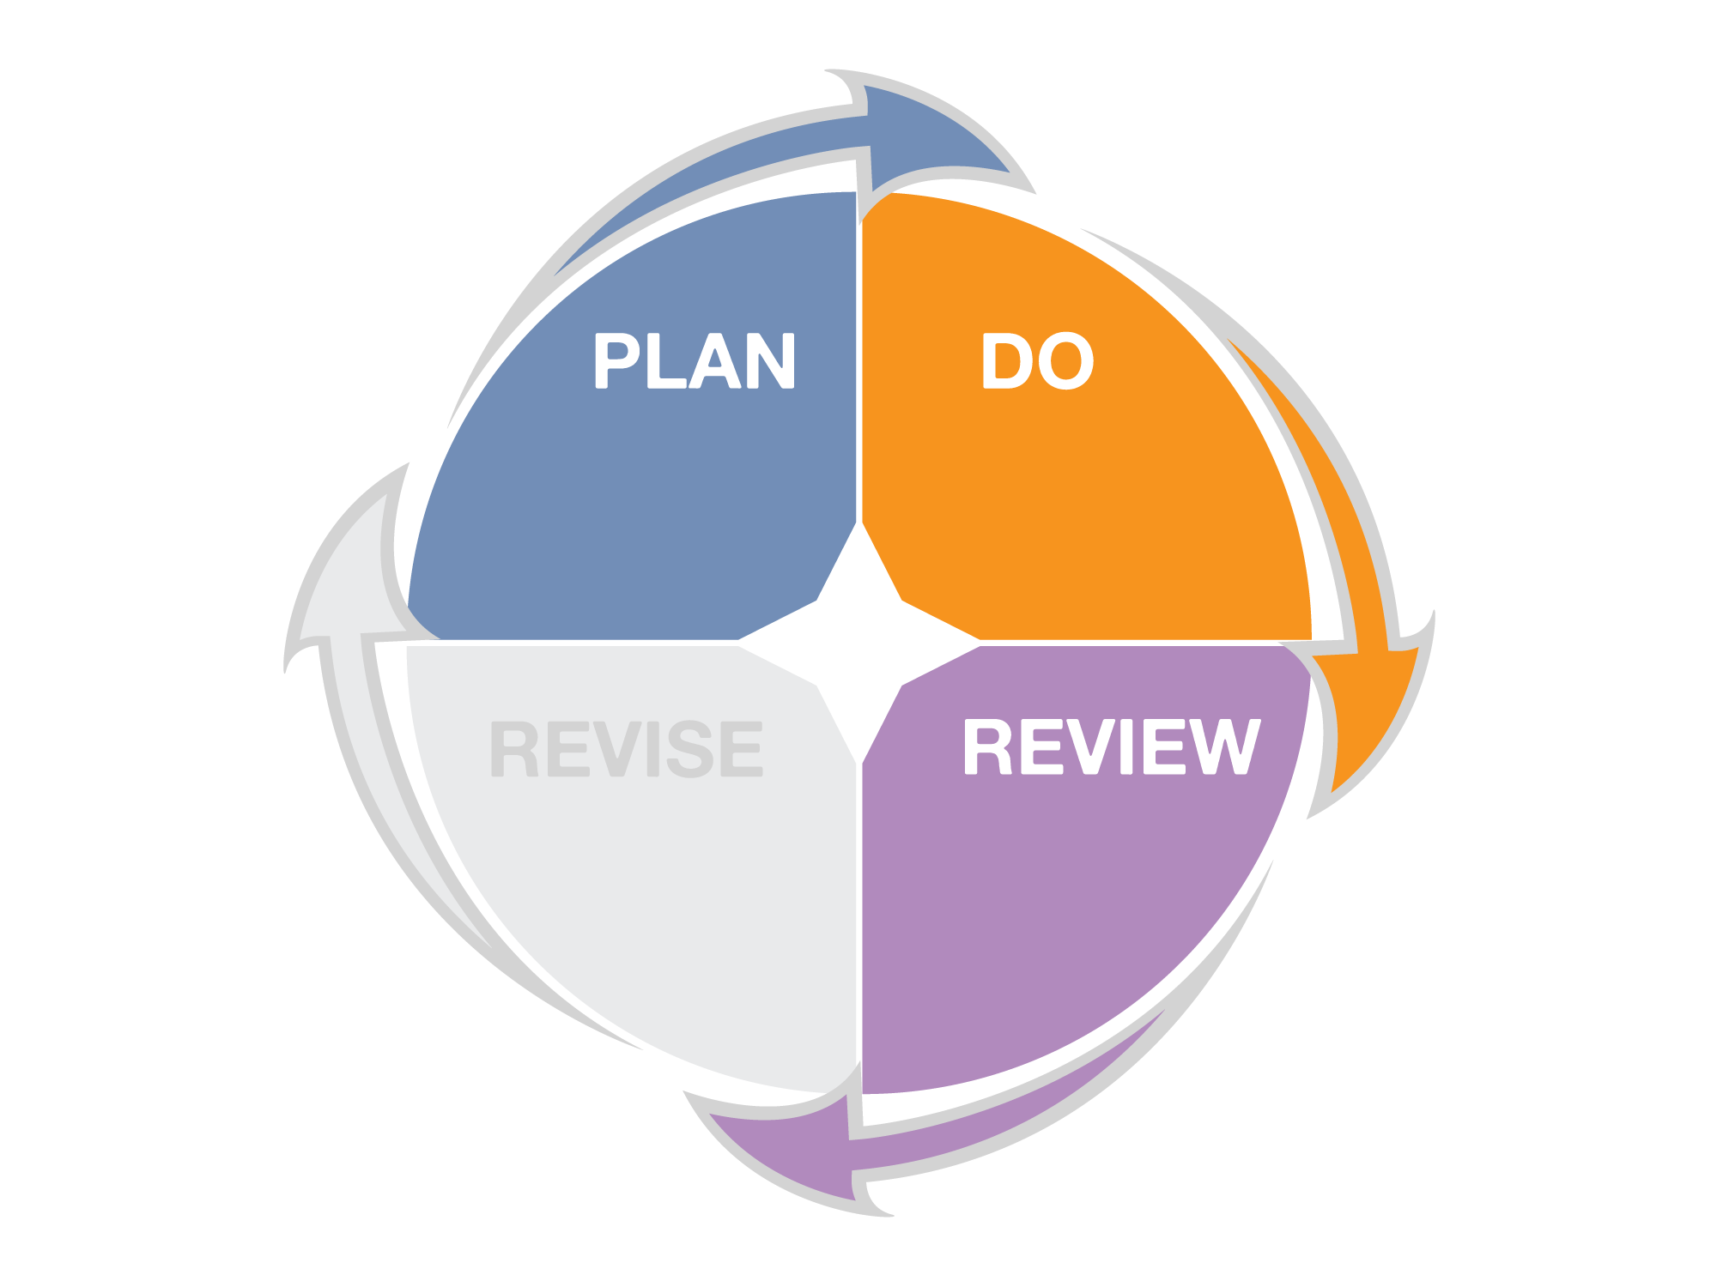
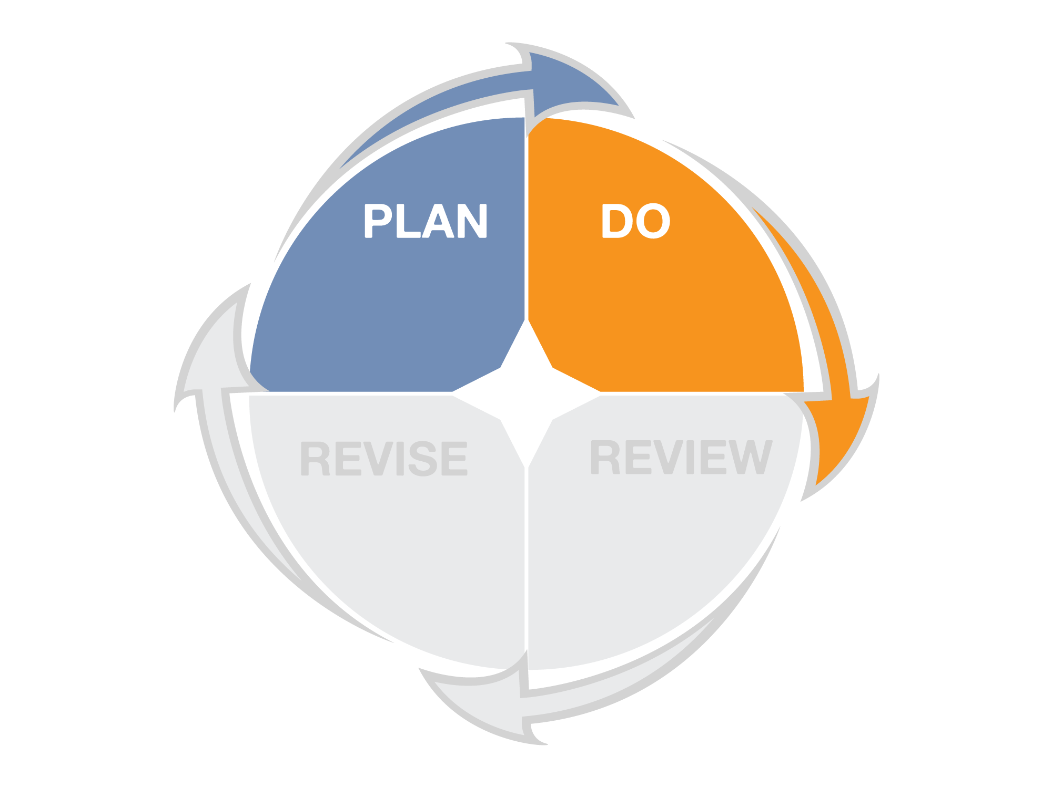
Performance Management Process
Align efforts to advance the mission and strategic goals
Select performance measures to track desired results
What are you
trying to achieve?
What must you do to achieve your desired results?
What must you improve to achieve your desired results?
How will you know if you are successful?
Identify standards and targets to evaluate success
Improve performance by formulating strategic objectives

Slide 5
Mission
What is our purpose? Why do we exist?
Goals
What are our main focus areas for the long- and short-term?
Values
What principles govern our actions and the way we do business?
Objectives
What efforts are needed to get results?
Initiatives
What specific activities must be done to ensure we meet the objectives?
Measures
How will we know if we are achieving results?

Slide 6
Outcome Model
IN SUPPORT OF A GOAL
TO ACHIEVE RESULTS
TO BENEFIT CUSTOMERS
TO DELIVER SERVICES
TO CONDUCT ACTIVITIES
WE USE RESOURCES

Slide 7
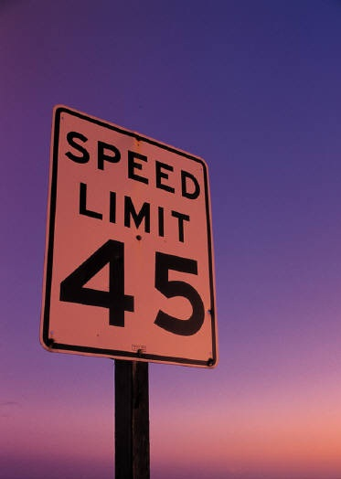
Example
To “Advance Transportation”
To avoid collisions
To discourage unreasonable speeds on local streets
By Issuing traffic citations
To enforce speed limits on streets
Officers are hired and given training, vehicles, and technology

Slide 8
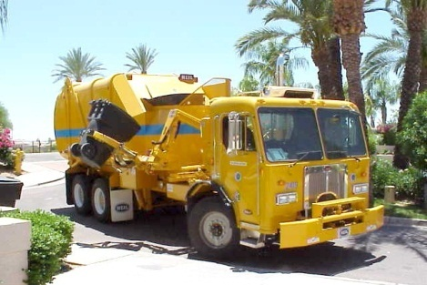
Internal Services
Strategy Model (Modified for Internal Services)
IN SUPPORT OF A GOAL
TO ACHIEVE RESULTS
TO BENEFIT CUSTOMERS
Public Services
TO DELIVER SERVICES
TO CONDUCT ACTIVITIES
WE USE RESOURCES
TO CONDUCT ACTIVITIES
TO DELIVER SERVICES
TO PROVIDE RESOURCES

Slide 9
Types of performance measures
Input
Amount of resources used (or available) to provide services
Output
Amount of work produced or services delivered
Outcome
The desired end result that demonstrates the impact of the services delivered
Indicators
Describe the environment in which the service is provided
Efficiency
Amount of work done per amount of resources used
Effectiveness
Amount of achieved results, or the level of quality relative to the amount of work done
Productivity
Amount of quality work done per amount of resources used
Conditions
External requirements or demands that impact service delivery
Cost-Effectiveness
Amount of outcome achieved per amount of resources used

Slide 10
Example
Inputs
Officers; Training;
Vehicles; Technology
Output
Citations Issued
Outcome
Discourage high speeds and avoid collisions
Indicators
Traffic volume
Efficiency
Citations issued per hour of active enforcement
Effectiveness
Compliance rate (+);
Collision rate (-);
Citizen satisfaction with traffic enforcement
Productivity
Compliance Rate per hour of active enforcement
Conditions
Laws regulating traffic enforcement; legal evidence requirements
Cost-Effectiveness
Cost to provide traffic enforcement services

Slide 11
Questions performance measures can help answer
Input
How much resources (staff/$$$, etc.) did you use?
Output
How much work was accomplished?
Outcome
What are the desired results (short-term or long-term)?
Indicators
How large is your service area? What population and demographics do you serve?
Efficiency
How much work was accomplished with available resources?
Effectiveness
How well did you achieve the desired results?
Productivity
How much time/effort was expended on quality work?
Conditions
What legal or regulatory requirements impact how you provide service?
Cost-Effectiveness
How much value was provided per dollar spent?

Slide 12
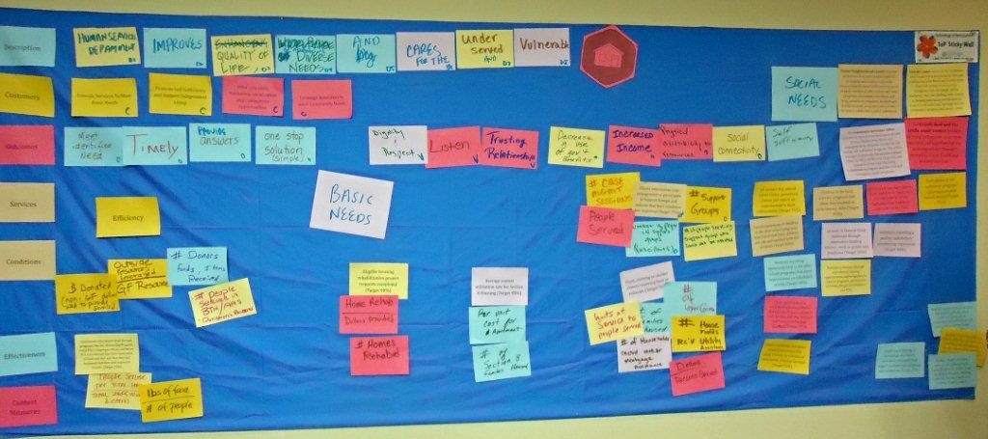
How to develop a consistent and intelligent approach to performance measurement in your department
1. What do you do? Describing your purpose
2. Why do you do it? Identifying outcomes
3. How do you do it? Counting inputs and outputs
4. How well do you do it? Measuring efficiency & effectiveness
5. Can you explain it to others?

Slide 13
Don’t settle for easy measures
“Never give up on an important goal that’s hard to measure in favor of a less important one that’s easy to measure.”
From Robert Lewis. 2009. “No metrics? Don’t fret; you can still manage without measuring.” Minneapolis St. Paul Business Journal.

Slide 14
“Evidence suggests that improved performance occurs at a much greater rate when performance measures are compared.” Smith and Hartung, 2004
Targets express a specific level of performance the organization is aiming to achieve.
Standards (also called “benchmarks”) express the minimum acceptable level of performance that is expected and achieved by other, high-performing organizations.
How else will you know how well you are doing without context?

Slide 15
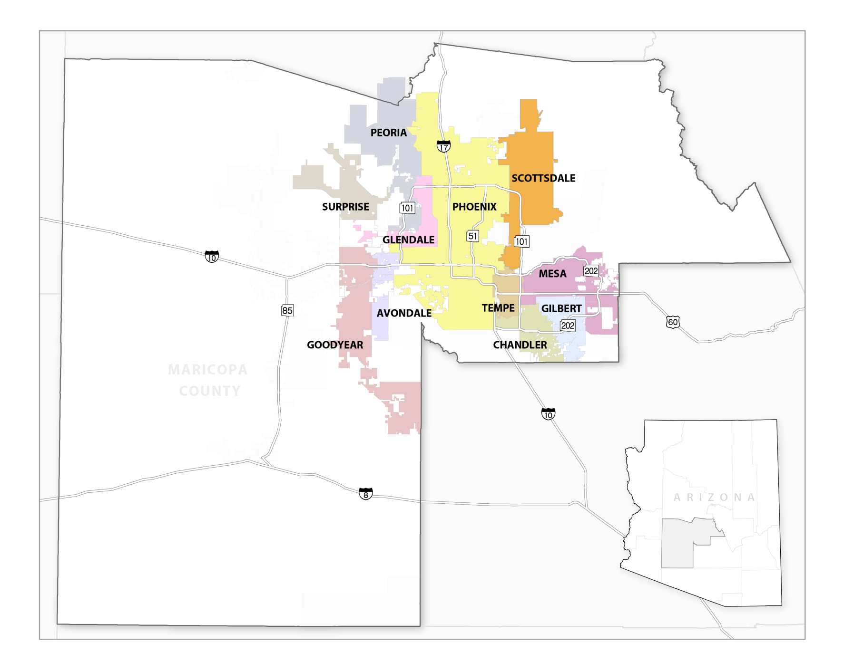
Valley
Benchmark Cities

Slide 16
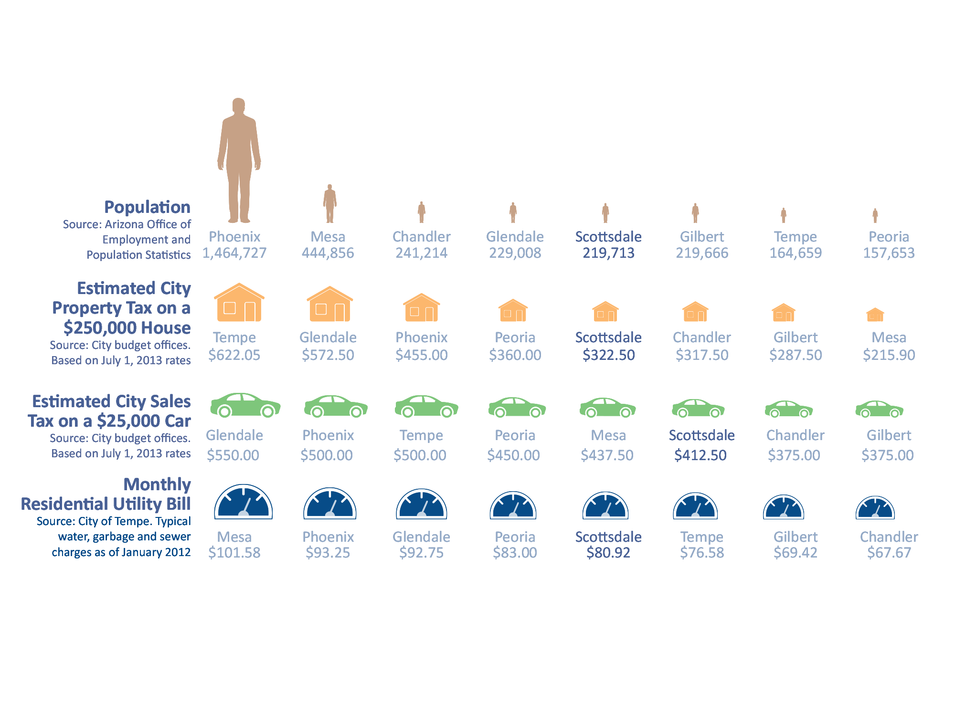
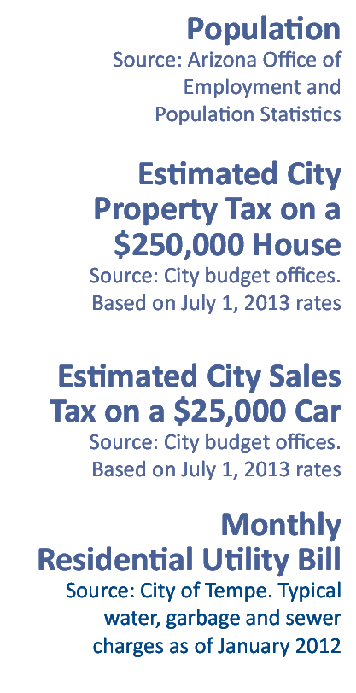
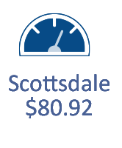
How do we compare with our neighbors?
Scottsdale is part of the Phoenix metropolitan area, and taxes and rates vary across the eight largest cities. Scottsdale’s taxes and rates are lower than all but two or three of the largest cities.

Slide 17
Why measure?
If You Don't Measure Results, You Can't Tell Success from Failure
If You Can’t See Success, You Can’t Reward It
If You Can’t Reward Success, You’re Probably Rewarding Failure
If You Can't See Success, You Can't Learn From It
If You Can't Recognize Failure, You Can't Correct It
If You Can Demonstrate Results, You Can Win Public Support
David Osborne and Ted Gaebler. 1992. Reinventing Government: How the Entrepreneurial Spirit Is Transforming the Public Sector.

Slide 18
Questions, Comments, Observations?
Brent Stockwell, Strategic Initiatives Director
Scottsdale City Manager’s Office
Bstockwell@ScottsdaleAZ.gov | 480-312-7288
www.ScottsdaleAZ.gov/departments/citymanager/performance

