Slide 1
How to make data less daunting and more meaningful
Brent Stockwell | Strategic Initiatives Director
Scottsdale, Ariz., City Manager’s Office
480-312-7288 | Bstockwell@ScottsdaleAZ.gov
www.ScottsdaleAZ.gov/departments/citymanager/performance
Moneyball (2011)

Slide 2
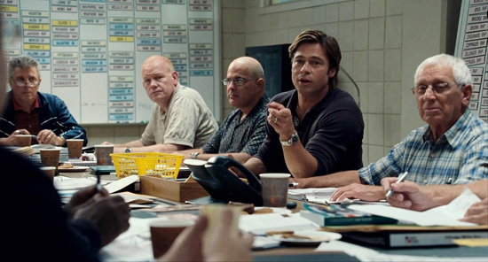
“People… operate with beliefs and biases.
To the extent you can eliminate both and replace them with data, you gain a clear advantage.”
Michael Lewis | Moneyball: The Art of Winning an Unfair Game
Moneyball (2011)

Slide 3
Pie I have eaten
12.5%
87.5%
Pie I have
not yet eaten

Slide 4
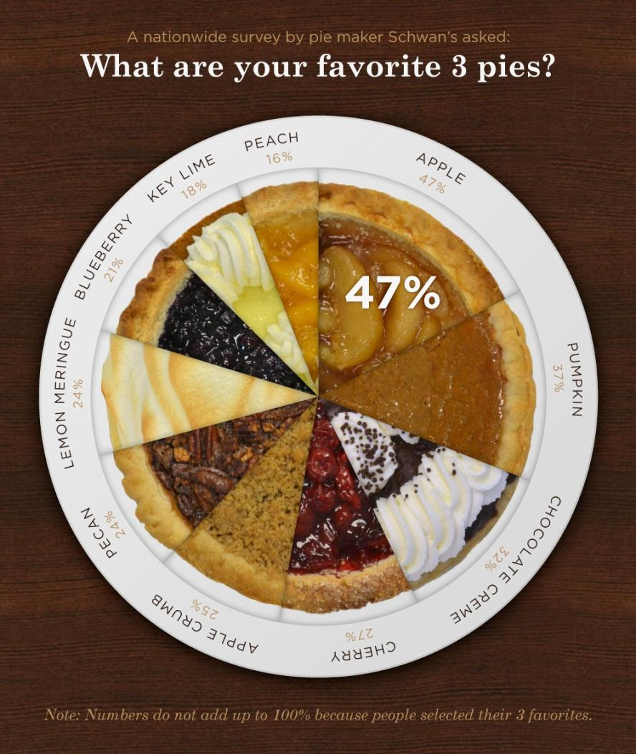
http://visual.ly/pie-charts

Slide 5
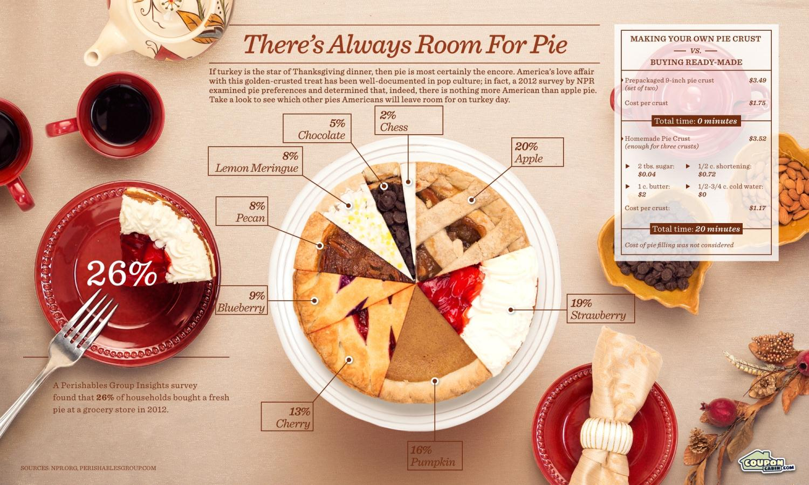
http://visual.ly/theres-always-room-pie

Slide 6
http://www.presentationzen.com/presentationzen/2007/03/a_few_weeks_ago.html

Slide 7
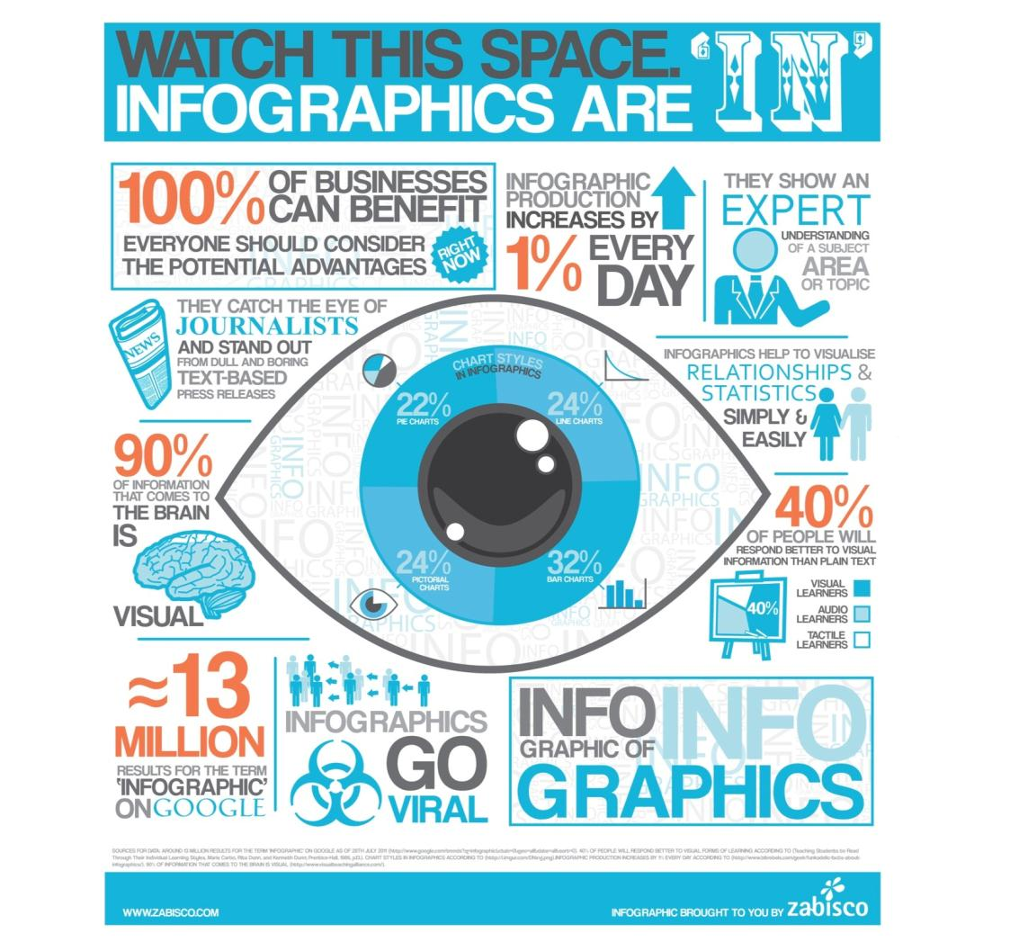
http://www.infographicsarchive.com/new-infographic/video-infographic-infographic-of-infographics/

Slide 8
“effective information visualization (is) premised on:
simplicity
(complex notions simplified to save time for reader);
transparency
(visual honesty and responsibility in sourcing);
creativity
(design that is memorable and understandable);
sociability
(easily shared and improved)”
@Sambrook
http://www.edelman.com/p/6-a-m/visualizing-information/

Slide 9
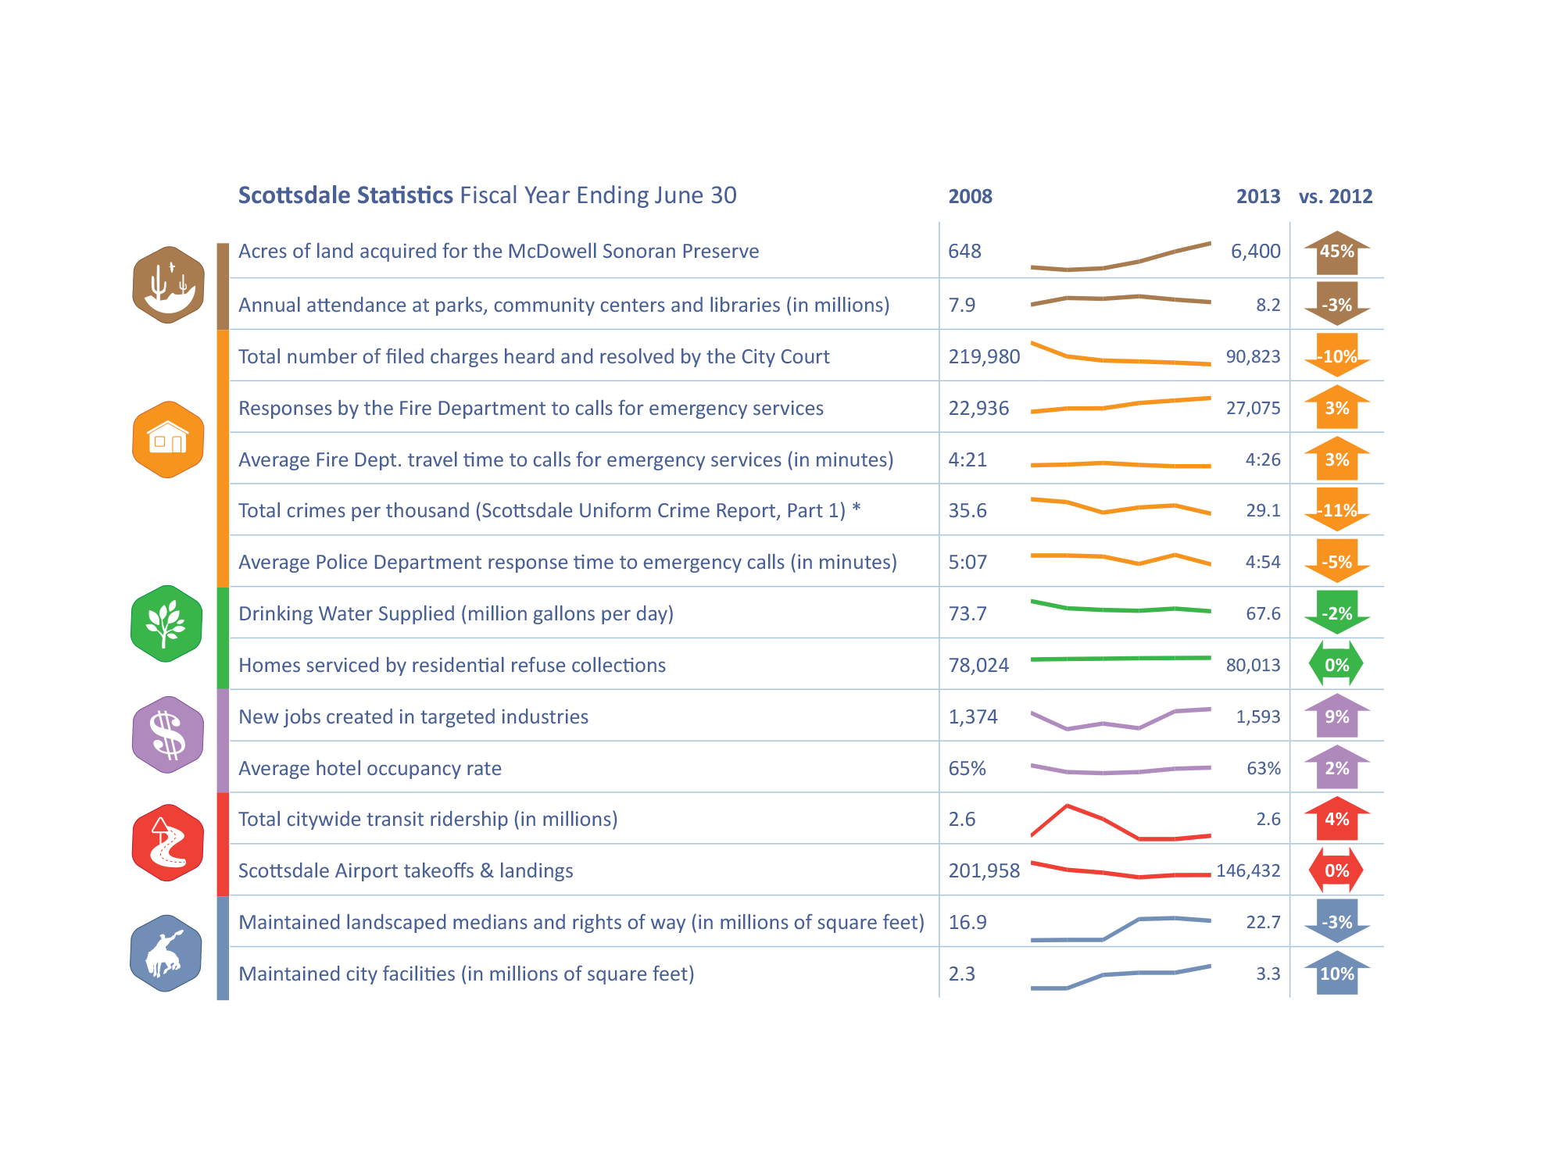
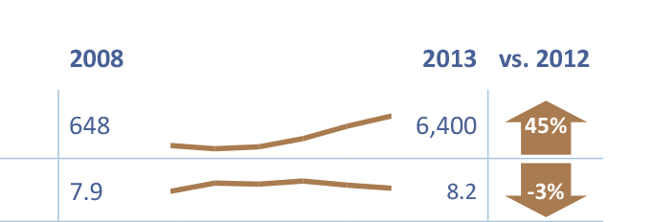
“effective information visualization (is) premised on:
simplicity
(complex notions simplified to save time for reader)

Slide 10
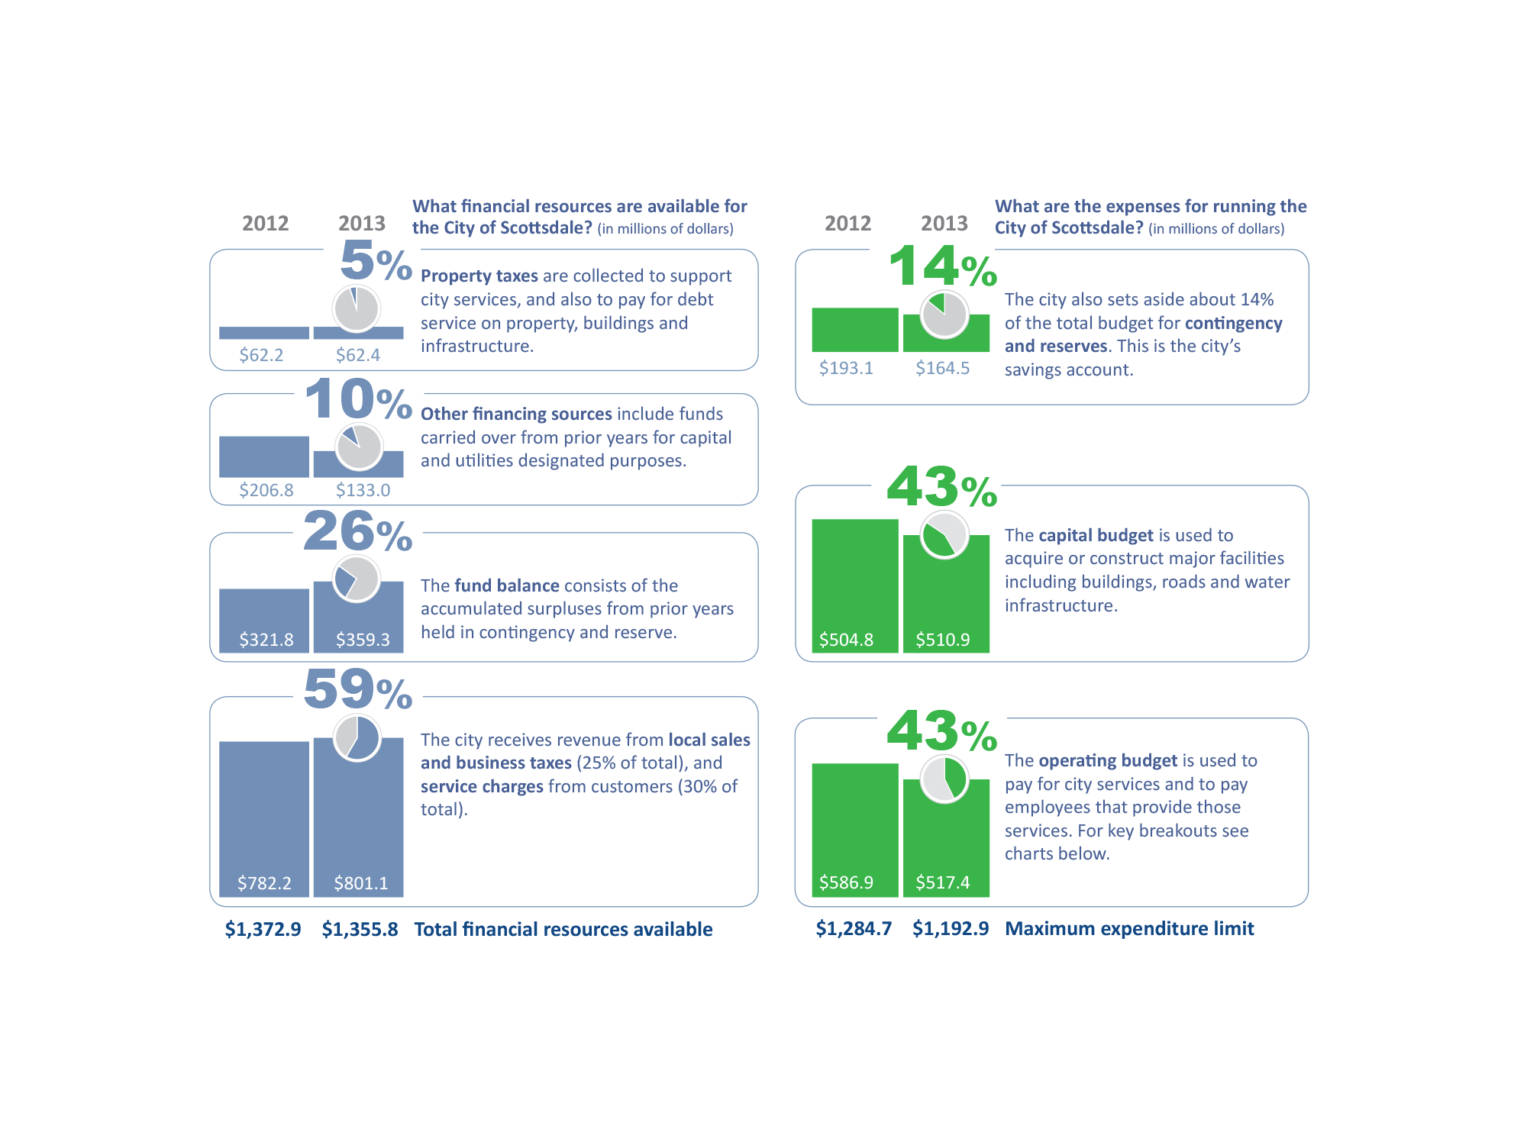
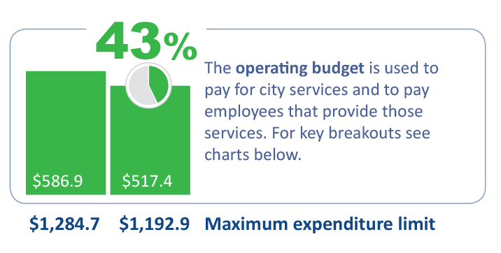
“effective information visualization (is) premised on:
transparency
(visual honesty and responsibility in sourcing)

Slide 11
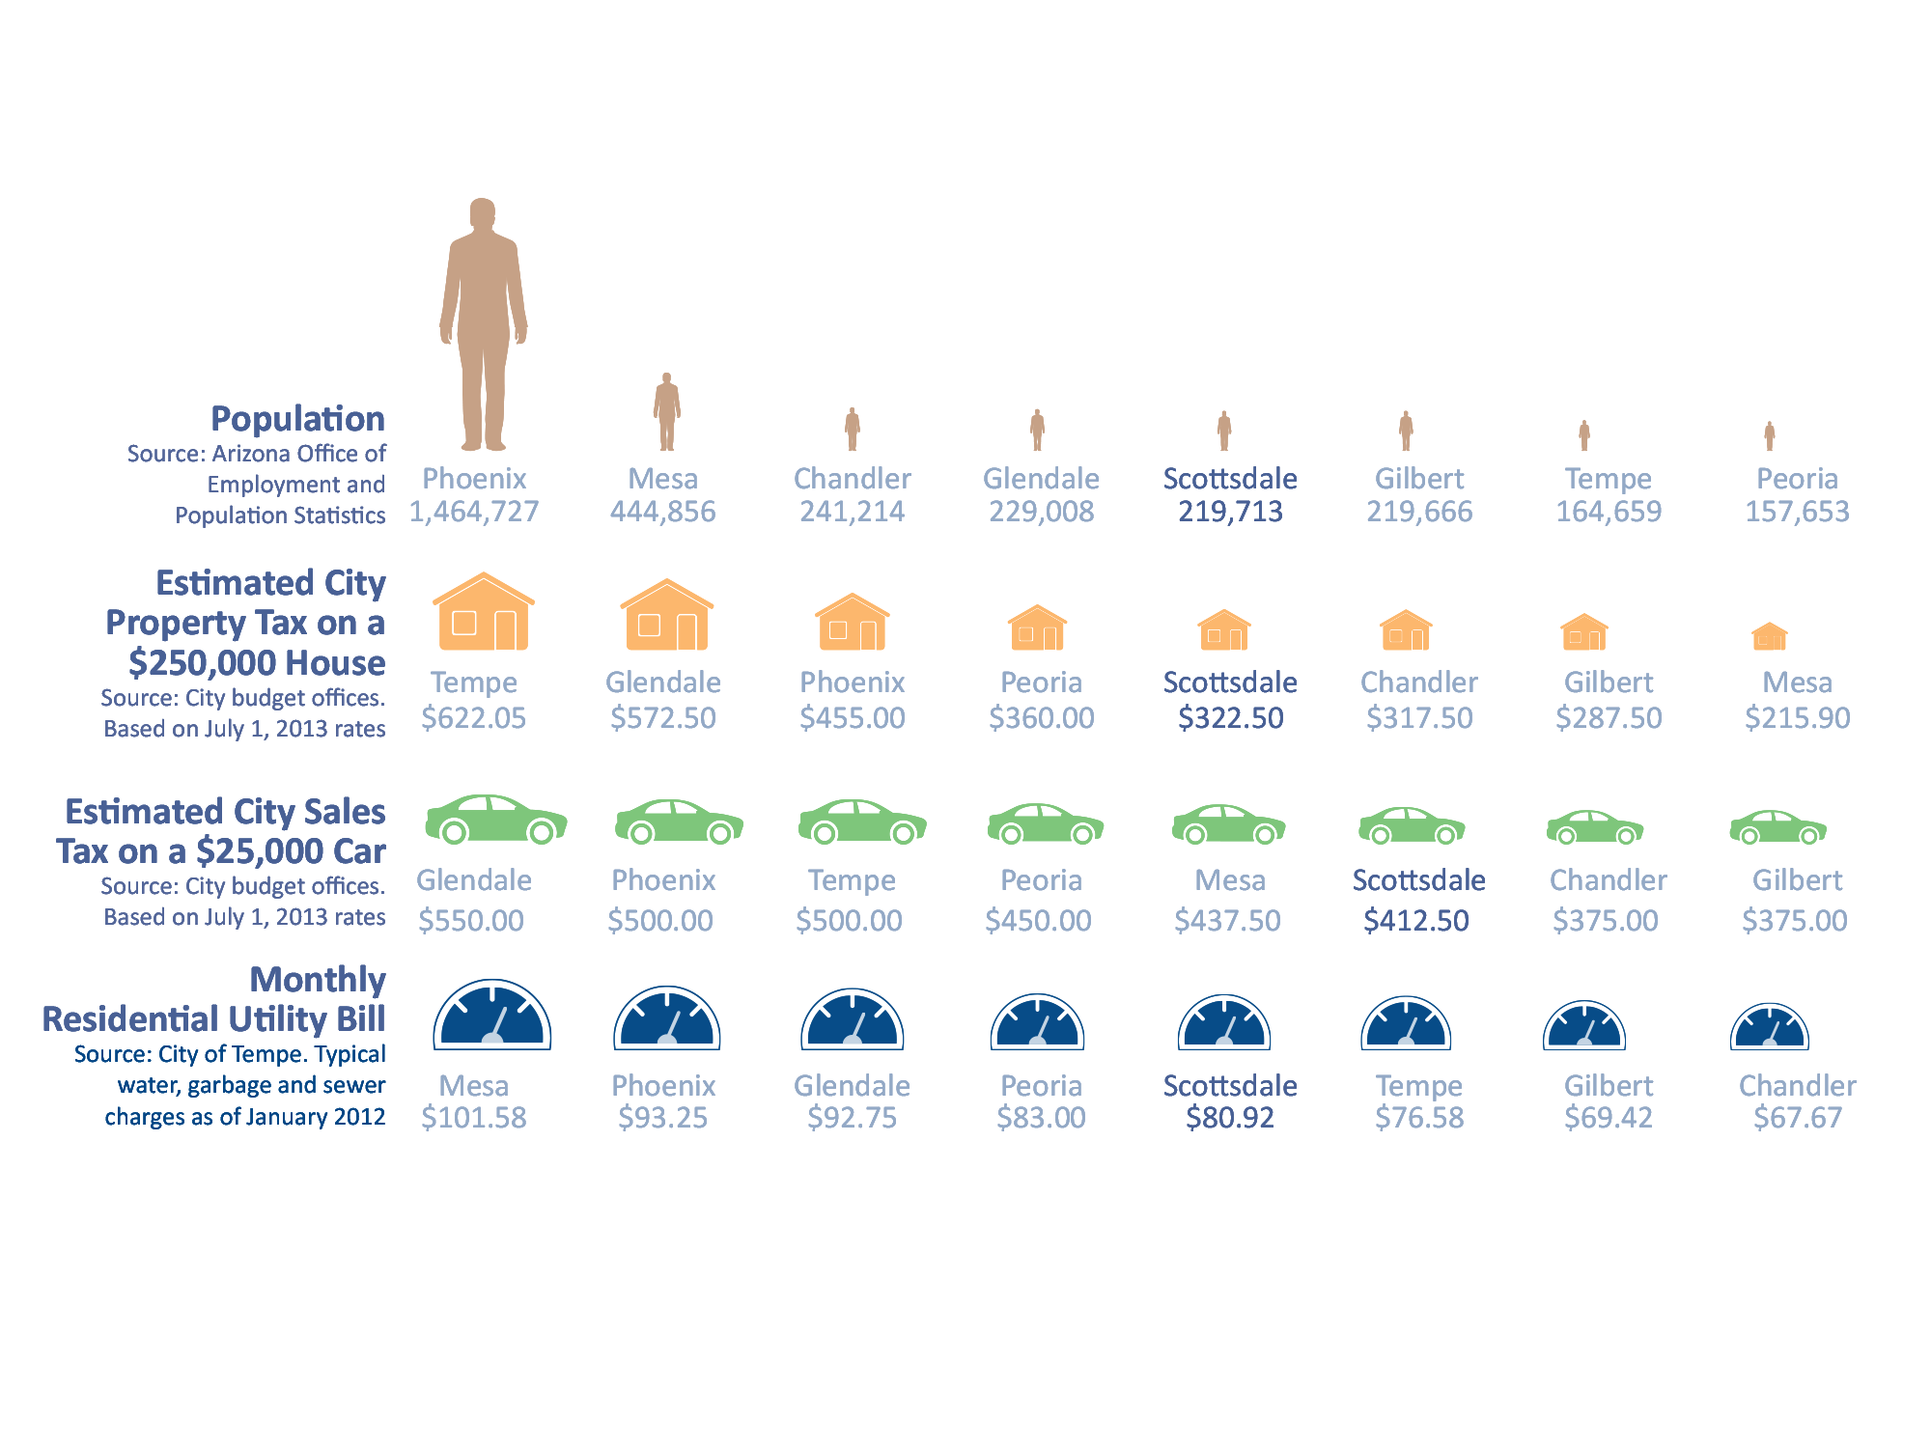
“effective information visualization (is) premised on:
creativity
(design that is memorable and understandable)

Slide 12
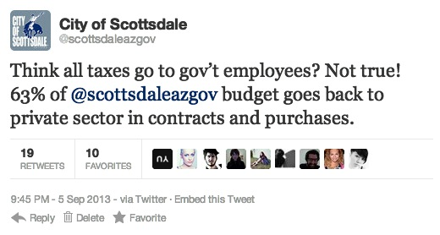
“effective information visualization (is) premised on:
sociability
(easily shared and improved)

Slide 13
Edward R. Tufte
The Visual Display of Quantitative Information, Edward R. Tufte, 2001
@EdwardTufte

Slide 14
Remove Chartjunk
“interior decoration of graphics generates a lot of ink that does not tell the viewer anything new.”

Slide 15
Increase Data-Ink
“data graphics should draw the viewer’s attention to the sense and substance of the data, not to something else.”

Slide 16
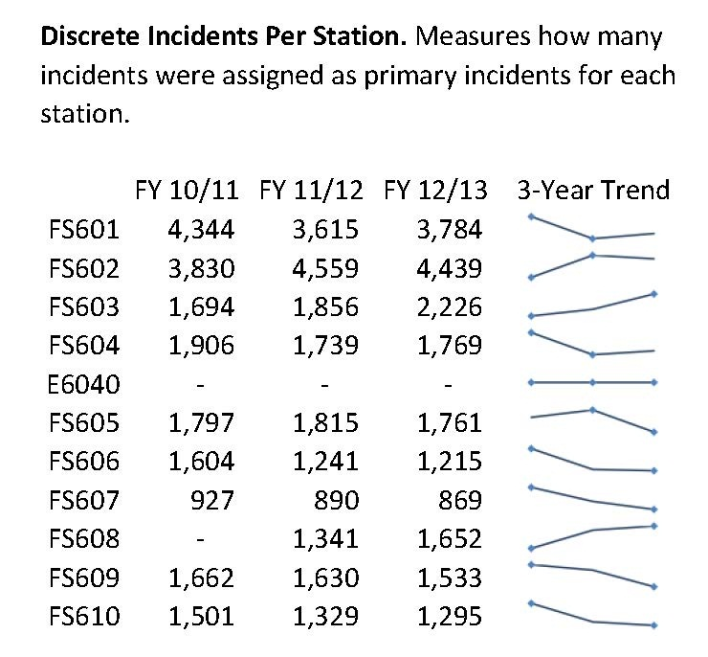
Sparklines
“Small, high-resolution graphics usually embedded in a full context of words, numbers, images. Sparklines are datawords: data-intense, design-simple, word-sized graphics.”

Slide 17
Accessible Complexity: The Friendly Data Graphic
Characteristics of friendly graphics
words are spelled out
words run from left to right
little messages help explain data
avoid elaborately encoded shadings, crosshatching and colors
labels are placed on the graphic itself; no legend is required
graphic attracts viewer, provokes curiosity
colors, if used, are chosen so that color-deficient and color-blind (5 to 10 percent of viewers) can make sense of the graphic (blue can be distinguished from other colors by most color-deficient people)
Type is clear, precise, modest
Type is upper- and lower-case, with serifs
The Visual Display of Quantitative Information, Edward R. Tufte, 2001, p. 183

Slide 18
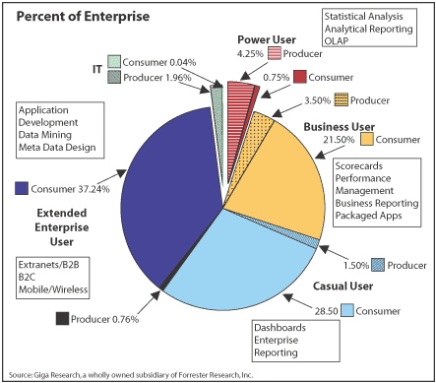
Before
Stephen Few
For more bad examples
http://www.perceptualedge.com/examples.php

Slide 19
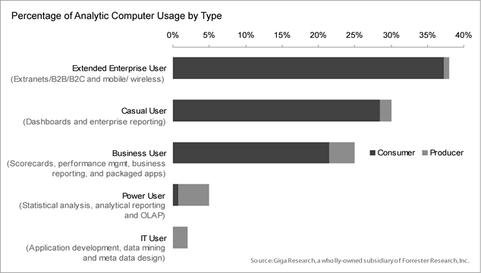
After
For more proposed solutions
http://www.perceptualedge.com/examples.php

Slide 20
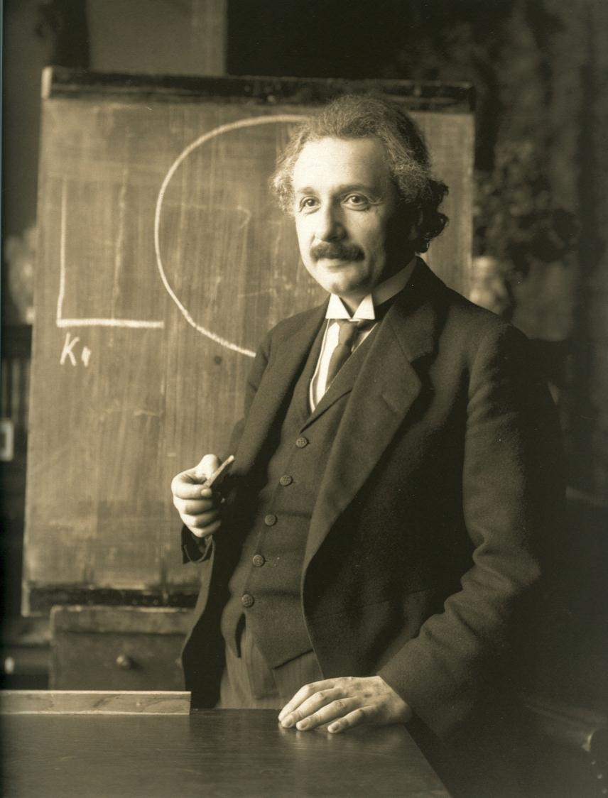
Everything should be made as simple as possible but no simpler.
“It can scarcely be denied that the supreme goal of all theory is to make the irreducible basic elements as simple and as few as possible without having to surrender the adequate representation of a single datum of experience.”
from “On the Method of
Theoretical Physics.”
Albert Einstein (1933)

Slide 21
Always be on the lookout for good (and bad) examples

Slide 22
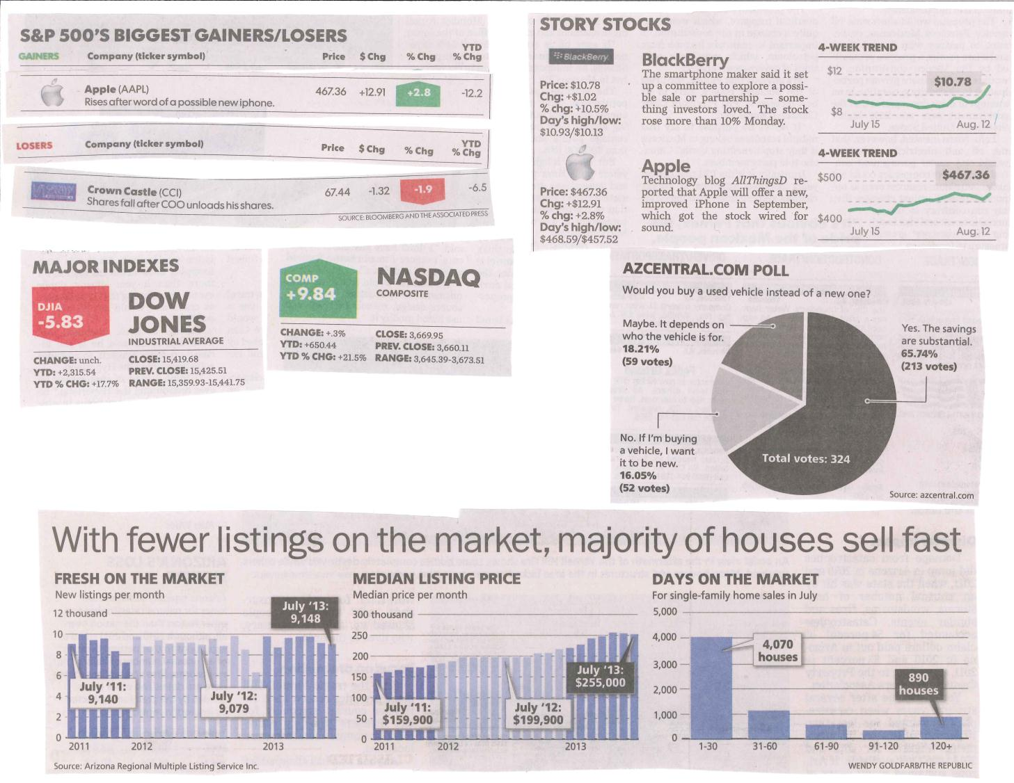

Slide 23
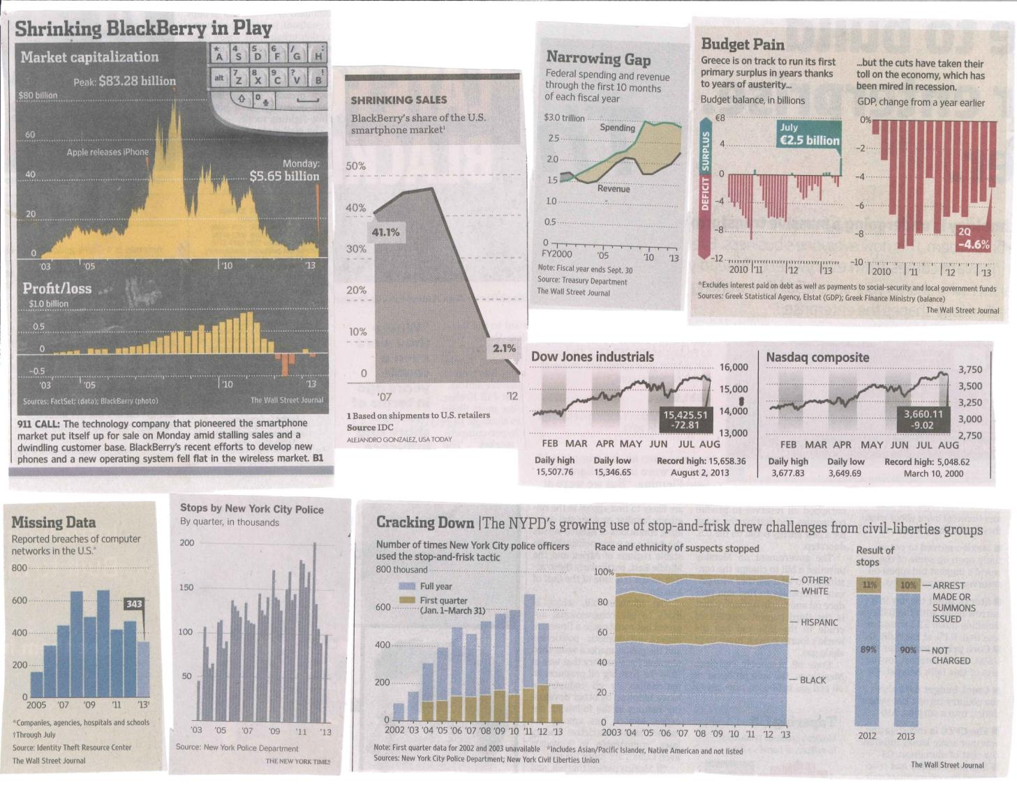

Slide 25
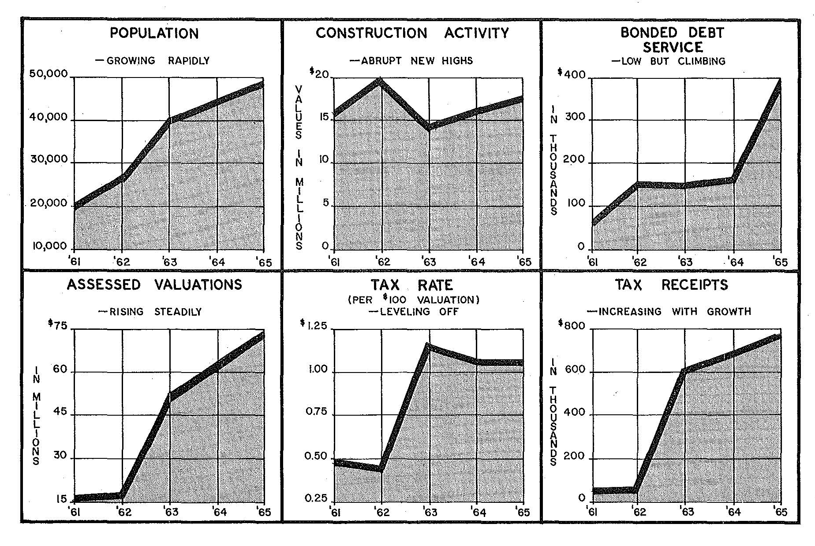
Technology is faster, but not necessarily simpler…
City of Scottsdale, FY 1964/65 Budget Book

Slide 26
Total Full-Time Attrition and Unemployment Rate
13.3%
11.0%
Retirements
10.0%
9.3%
8.4%
4.4%
Unemployment Rate
Retirement
Incentive
Program
Other Turnover

Slide 27
Facilities Growth and Facilities Staffing
Facilities Growth
Facilities Staffing

Slide 28
First Response Unit - Station 602 Area
10% more calls
93%
7% OTHERS
601 3%
603 3%
PHX 1%
TEMPE .2%
77%
23% OTHERS
601 13%
603 7%
PHX 4%
TEMPE .3%
FY 2011/12
1.9 companies
Station 602
6,161 Calls
FY 2012/13
1.1 companies
Station 602
6,784 Calls

Slide 29
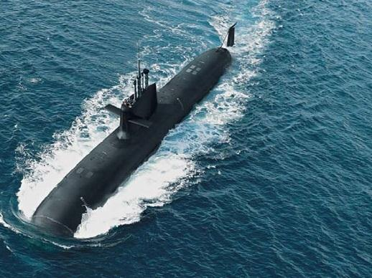
Accuracy is the key to credibility
http://rt.com/news/spanish-submarine-cannot-resurface-634/

Slide 30
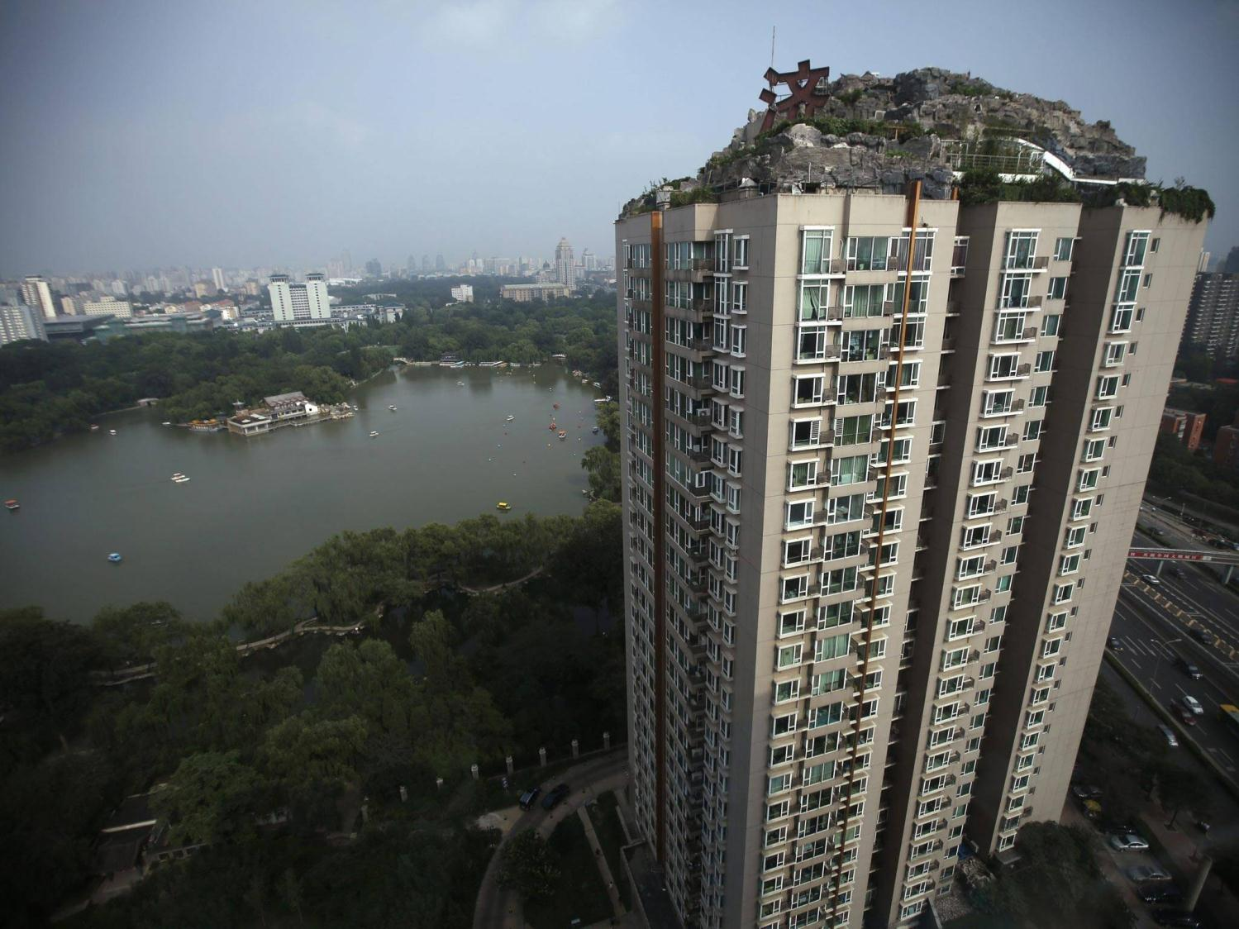
Don’t overdo it
http://www.independent.co.uk/incoming/article8757905.ece/BINARY/original/china-1.jpg

Slide 31
Design for your audience
Avoid default settings
Remove unnecessary information
Use animation feature to tell your story
Move beyond charts and use shapes/pictures
Ask for feedback – does it make sense to others?

Slide 32
“effective information visualization (is) premised on:
simplicity
(complex notions simplified to save time for reader);
transparency
(visual honesty and responsibility in sourcing);
creativity
(design that is memorable and understandable);
sociability
(easily shared and improved)”
@Sambrook
http://www.edelman.com/p/6-a-m/visualizing-information/

Slide 33
Questions, Comments, Observations?
Brent Stockwell | Strategic Initiatives Director
Scottsdale, Ariz., City Manager’s Office
480-312-7288 | Bstockwell@ScottsdaleAZ.gov
www.ScottsdaleAZ.gov/departments/citymanager/performance
Moneyball (2011)

