Slide 1
Applicant Orientation
FY 2021-2022 CDBG, HOME, Scottsdale Cares,
General Funds
and Endowment Funds
Notes:
Good morning and welcome to the Applicant Orientation for Fiscal Year 2021-2022. I am Justin Boyd, Housing Supervisor for the City of Scottsdale. We appreciate you taking the time out of your busy schedules to be here with us this morning.

Slide 2
Agenda for today’s meeting
Funding Packet Overview
Calendar of Events
Administrative Changes
Human Services Staff Evaluation
Agency Proposal Evaluation Tool
CDBG Funds
HOME Funds
Scottsdale Cares
General Funds
Endowment Funds
Proposal Submission
Questions
Staff Contacts
Notes:
A copy of the agenda for today’s meeting was provided at the front door, please feel free to follow along as we cover:

Slide 3
Orientation Purpose
Provide an overview of the FY 2021/2022 Funding Process for all funding sources
Present anticipated Funding Allocations
Strengthen your agencies understanding of how to develop a quality Proposal that can successfully compete for funding
Review National Objectives, Eligible Activities and Regulatory Concerns
Provide staff contacts for technical assistance in the development of your Proposal
Notes:
The purpose of today's Orientation is to…
Staff will also be available upon the conclusion of today’s presentation to answer any additional questions that you might have.

Slide 4
Why have a combined proposal process?
All funding sources are considered at one time by the Human Services Commission and City Council
Gives a big picture overview of funds requested
Allows other funding sources to be used for eligible Proposals
All Proposals are submitted to the Community Assistance Office
All contracts are administered by the Community Assistance Office
Notes:
Read Slide

Slide 5
Funding Packets Overview
Funding Packets are available online at: https://www.scottsdaleaz.gov/human-services/funding-information
  Proposal/Allocation Calendar
  Letter from the Human Services Commission Vice-Chair
  Notice of Funding Availability
  Eligible Activities and General Information
  Proposal
  Human Services Staff Evaluation
  Agency Proposal Evaluation Tool
  Evaluation Tool Guidelines
  Federal Regulation (CDBG and HOME)
  Budget Requirements for Submittal
  PowerPoint Presentation
Notes:
This year’s funding packets are available online at the link illustrated on the slide. The webpage can also be easily located by entering “Funding Information” into the search engine, on the City’s website. The webpage includes a folder for each funding source that contains… (read the slide)

Slide 6
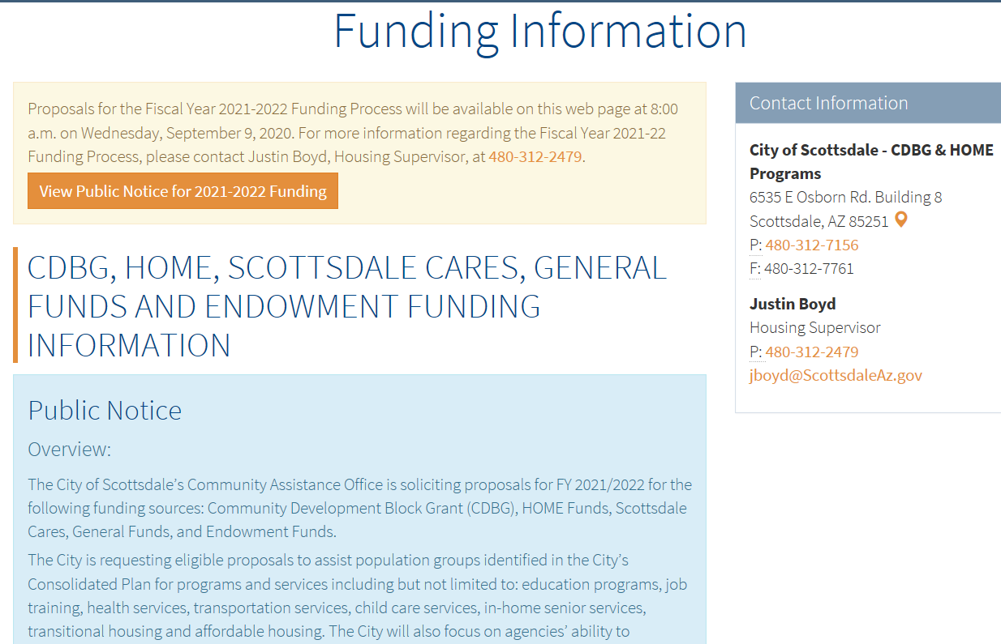
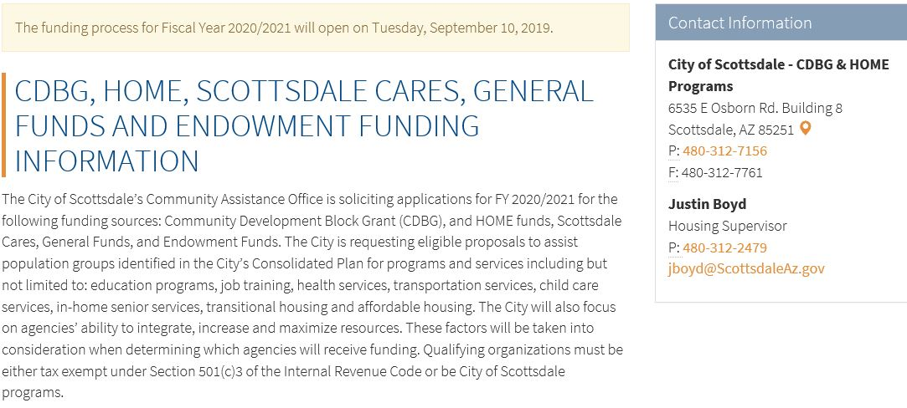
Funding Packets
Overview Continued
Notes:
This slide shows the link for the webpage that contains the funding information for fiscal year 2021-2022.

Slide 7
Calendar of Events
(Key Dates)
Proposals due, electronically, on Friday, October 23, 2020 by 4:00 p.m.
Responses to Human Services Staff Evaluation are due approximately December 1, 2020.
CDBG and HOME Presentations will be held on Tuesday, February 9, 2021.
Scottsdale Cares, General Funds and Endowment Funds Presentations will be held on Thursday, February 11, 2021.
Human Services Commission formal recommendations to City Council will be held on Thursday, March 25, 2021.
City Council votes on approval of CDBG and HOME funding tentatively on April 27, 2021.
City Council votes on approval of Scottsdale Cares, General Funds and Endowment Funds tentatively on June 15, 2021.
Notes:
(Read Slide)
This funding year proposals are due electronically by 4:00pm on Friday, October 23, 2020 and responses to the Human Services Staff Evaluations are due on approximately December 1, 2020.
This year the Human Services Commission has requested that during the presentations on February 9th and 11th agencies continue to focus on the proposed activity and not the organization as a whole.

Slide 8
Administrative Changes
Each agency will be limited to
submitting 1 electronic proposal per funding source.
  Will be verified through the agency’s Tax ID Number.
Scottsdale Cares agencies will not receive more than 15%
of the total funding amount available.
General Fund agencies will not receive more than 20% of
the total funding amount available.
Scoring sections of the Evaluation Tool have been simplified (now ranges from 0-3)
Notes:
Each agency will be limited to submitting only 1 electronic proposal per funding source. The Human Service’s Staff will be confirming the submission based upon the agencies Tax Identification Number.
Funding request for Scottsdale Cares will not receive funding allocations that exceed 15% of the total funding amount available.
The same rule applies to funding requests received for General Funds with the exception of a 20% threshold.
Scoring for all sections of the Evaluation Tool have been simplified. The new scoring system now ranges from 0 -3.

Slide 9
Administrative Changes
(continued)
Response to the Human Services Staff Evaluation will be emailed to the agency contacts listed in the proposal in Late November.
  This will be the only opportunity to present additional information during the funding process.
  Provide a list containing 2 different agency contacts with email addresses to ensure timely transmission of the Human Services Staff Evaluation (Proposal, page 1).
  Any Agency that fails to attend and present for their presentation will receive 0 points for presentation.
  Any Agency that fails to respond to the Human Services Staff Evaluation or submits their response after the December deadline, will receive a 10 point reduction.
  Any Agency that fails to attend and present at the agency presentation and doesn’t submit a response to the Human Services Staff Evaluation will be disqualified from the funding process.
Notes:
Response to the Human Services Staff Evaluation will be emailed to the agency contacts listed in the proposal in Late November.
This funding year, the Human Services Staff Evaluation will be the only opportunity for your agency to provide additional information during the funding process.
Please provide a list containing 2 different agency contacts with valid email addresses to ensure transmissions are received in a timely manner.
These contacts will be assigned to perform the Service or supervise the performance of the Service for an executed Subrecipient Agreement. In addition, please be sure to identify the contact with signature authority. If there are any changes, a revised contact sheet must be submitted by the grantee within thirty (30) days of the change.
Any Agency that fails to attend and present for their presentation will receive 0 points for their presentation score.
Any Agency that fails to respond to the Human Services Staff Evaluation or submits their response after the December deadline, will receive a 10 point reduction.
Any Agency that fails to attend and present at the agency presentation and doesn’t submit a response to the Human Services Staff Evaluation will be disqualified from the 2021/2022 funding process.

Slide 10
Examples of Funding Caps for
Scottsdale Cares and General Funds
Scottsdale Cares 15% CAP
Agency Requested Amount | Estimated Scottsdale Cares Allocation | Agency Requested Amount reduced by | Final Agency Requested amount
$35,000 | $150,000 | $12,500 | 22,500
General Funds 20% CAP
Agency Requested Amount | Estimated General Funds Allocation | Agency Requested Amount reduced by | Final Agency Requested amount
$45,000 | $200,000 | $5,000 | $40,000
Notes:
This slide demonstrates examples of funding requests received for Scottsdale Cares and General Funds, as they pertain to the 15% and 20% thresholds.
For example:
If an agency submits a proposal requesting $35,000, and the total funding amount available is $150,000 for Scottsdale Cares, the request for funding will be reduced by $12,500, to coincide with the 15% threshold. Therefore, the maximum allocation this proposal’s request for funding could receive is $22,500.
The same methodology is illustrated for the 20% threshold for General Funds.

Slide 11
Human Services Staff Evaluation
Proposals will be reviewed by City Staff to determine general eligibility and completion.
Human Services Staff will analyze the content of each application and compile clarifying inquiries, if warranted.
Finalized Human Service Staff Evaluations will be emailed to each agency by approximately November 23, 2020.
  Responses are required by approximately December 1, 2020. This will be the only opportunity to present additional information during the funding process.
Responses will be included in the funding documents prepared for the Human Services Commission for review and scoring.

Slide 12
Agency Proposal Evaluation Tool
Scoring for all sections of the Evaluation Tool have been simplified
Tool used by Human Service Commission to rank Proposals
Refer to Evaluation Tool as you fill out the Proposal
Section 6: Demonstrated Capacity will be evaluated and scored by City staff
Simplified Evaluation Tool for Endowment Funds
Notes:
Scoring for all sections of the Evaluation Tool have been simplified. The new scoring system now ranges from 0 -3.
Agencies not funded but requested funding in previous year will receive 2’s
Agencies funded in the proceeding year will be scored based upon that year’s performance
Agency that requested Scottsdale Cares and General Funds in the prior fiscal year and are transitioning to CDBG/HOME proposals will receive a neutral score of 2 for their activity due to the additional federal reporting requirements
Agency’s requesting funding for a new activity/service will receive a neutral score of 2
The Agency Proposal Evaluation Tool is used by the Human Services Commission to rank proposals. Please refer to the Evaluation Tool as you complete your proposal.
A simplified version of the Endowment Evaluation Tool has been established to more effectively evaluate and score the proposal for this funding year.

Slide 13
Evaluation Tool Guidelines
Provided in Funding Packets available at: https://www.scottsdaleaz.gov/human-services/funding-information
Evaluation Tool has been updated to reflect the new scoring scale.
Guidelines utilized by Human Service Commissioners to accurately complete the Agency Proposal Evaluation Tools
Identifies criteria for scoring sections of the Agency Proposal Evaluation Tools
Distinguishes where information can be referenced in the proposal
Notes:
Please review the Evaluation Tool Guidelines, which are available at the link illustrated on the slide, so you can easily reference how your proposal will be evaluated and scored.
I would definitely encourage reading the Evaluation Tool Guidelines prior to working on your proposal.
The Evaluation Tool has been updated to reflect the new scoring scale.

Slide 14
CDBG Funds

Slide 15
National Objectives
Projects must meet one of the following:
  Primary Benefit to Low and Moderate Income Persons
  Prevention or Removal of Slum and Blight
  Mitigation or Elimination of a Certified Emergency Condition (e.g. major catastrophes or emergencies such as floods and earthquakes).
Notes:
The Community Development Block Grant program enables communities to finance a variety of activities. Under the CDBG program, funding must be used to meet one of the following national objectives:
Primary Benefit to Low and Moderate Income Persons
Prevention or Removal of Slum and Blight
Or the Mitigation or Elimination of a Certified Emergency Condition

Slide 16
Types of Eligible Projects
Acquisition of Real
Property
Disposition (disposal
of real property)
Historic Preservation
Housing Rehabilitation
Housing Services
Lead Based Paint
Hazard Removal
New Housing
Construction
Program Administration
Costs (generally
reserved for the City
exclusively)
Public Facilities and
Improvements
Public Services
Relocation
Removal of
Architectural Barriers
Notes:
The primary objective of the CDBG Program is to develop viable urban communities, by providing decent housing and a suitable living environment, and expanding economic opportunities, principally for low and moderate income persons.
Here is a list of eligible activities that can be carried out with CDBG funds.
Pause…
It is important to remember that activities must meet a national objective and be an eligible project.

Slide 17
Types of Proposals
CDBG Proposals:
  Public Service
  Housing
  Facilities
Notes:
For Funding year 2021/22, we have 3 CDBG proposals. This will hopefully alleviate any confusion when determining what associated proposal needs to be filled out for the corresponding activity.
We have CDBG proposals entitled: Public Service, Housing and Facilities.

Slide 18
Housing Proposals
For acquisition activities, attach the following
narrative on a separate sheet:
    Project Timeline
    Fair Market Value of Property
    Relocation Information
    Environmental Information
Notes:
For Housing proposals you will need to attach the following narrative on a separate sheet that addresses each of the following:
Project Timeline
Fair Market Value of Property
Relocation Information
Environmental Information

Slide 19
Facility Proposals
For facility activities, attach the following
narrative on a separate sheet:
    Construction scope of work and estimates
    Construction plans for associated project (if available)
    Construction timeline
    Construction cost contingency (for project
  cost overruns)
Notes:
For facility proposals you will need to attach the following narrative on a separate sheet that addresses each of the following:
Construction scope of work and estimates
Construction plans for associated project (if available)
Construction timeline
Construction cost contingency (for project cost overruns)

Slide 20
Significant Regulatory Concerns
Environmental Reviews
Davis-Bacon Wages
Section 3
Procurement
Relocation
City Plan Review
Conformance with Current Land Use
Notes:
Understanding the specific regulatory requirements that are triggered by the proposed activity is an important factor to consider when developing your proposal.
Some regulatory concerns to take into consideration are: (read bullet points)
Environmental Reviews
Davis-Bacon Wages
Section 3
Procurement
Relocation
City Plan Review
Conformance with current land use requirements
Davis Bacon and Relocation could significantly increase the cost of your project. Please evaluate these regulatory concerns when completing the total budget summary.
When considering the submission of a facility improvement proposal we highly suggest meeting with the City’s Planning department to determine if your potential project is in conformance with the sites current land use. If your site operates on a conditional use permit, facility improvements may prompt an amendment to the use permit. The amendment process may delay or indefinitely postpone the potential project.

Slide 21
Anticipated CDBG Allocation
Total CDBG Allocation | $ | 1,205,605
Less: Admin Allocation of 20% | $ | (241,121)
Net CDBG Funds to Allocate | $ | 964,484
Public Service Allocation of 15% | $ | 180,841
Non-Public Service Allocation of 65% (includes $71,424 in reprogrammed funds) | $ | 855,067
*The City reserves the right to retain CDBG funds for specific activities.
Notes:
Our anticipated CDBG allocation absent the 20% administrative allocation provides funds in the amount of Nine Hundred, Sixty-Four Thousand, Four Hundred and Eighty-Four Dollars ($964, 484).
The total CDBG allocation is separated into a 15% allocation for Public Service activities of One Hundred Eighty Thousand, Eight Hundred and Forty-One Dollars ($180,841) and a Non-Public Service allocation of 65%, which includes reprogramed funds of Seventy-One Thousand, Four Hundred and Twenty-Four Dollars ($71, 424) for a total of Eight Hundred Fifty-Five Thousand, and Sixty-Seven Dollars ($855,067) for Non-Public Service activities.

Slide 22
Monthly Reporting
Focus on:
Number of Scottsdale persons or households to be assisted
Demographics
Income Levels
Due no later than the 15th of each month
Notes:
Monthly reports focus on:
The number of Scottsdale persons or households to be assisted
Beneficiary demographics
And beneficiary income levels
Monthly reports are due no later than 15th of each month regardless of lack of activity
It is important for us to receive the reports on time in order to accurately provide this information to HUD.

Slide 23
Reimbursement Requirements
Comply with all insurance requirements
Copies of supporting documentation (e.g. timesheets, payroll ledgers, invoices and proof of payment)
If paying for salaries must be able to identify time spent to Scottsdale funded activity (direct services)
  Ineligible reimbursement expenses include, but are not limited to over-time, paid time off and retro pay
Submit ONLY one (1) copy of your reimbursement request – by email
Notes:
The following is an overview of the reimbursement requirements:
Agencies must comply with all insurance requirements.
They must provide copies of supporting documentation such as timesheets, payroll ledgers, invoices and proof of payment.
If the activity includes salaries the agency must be able to identify the time spent on the Scottsdale funded activity.
Salaries for over-time, paid time off and retro pay are ineligible for reimbursement.
Submit ONLY one (1) copy of your reimbursement request – by email.
NEW - If your documentation for a reimbursement request are too large to email, then a hard copy must be received in our office no later than the 15th of each month.

Slide 24
HOME Funds
Notes:
The objective of the HOME Program is to provide decent affordable housing to low income households.

Slide 25
Eligible Projects
Acquisition/Rehabilitation of Multi-Family
New Construction of Multi-Family
Housing Rehabilitation
Homeownership
Notes:
The following are eligible projects under the HOME program:
Acquisition/ Rehabilitation of Multi-Family Housing
New Construction of Multi-family Housing
Housing Rehabilitation
And Homeownership programs

Slide 26
Anticipated HOME Allocation
Total HOME Allocation | $ 428,647.13
Less: 15% CHDO Set-Aside | $ (64,297.07)
Less: Maricopa County Admin of 5% | $ (21,432.36)
Less: Scottsdale Admin of 5% | $ (21,432.36)
Estimated HOME Funds Available | $321,485.35
Notes:
The anticipated HOME allocation for FY 2021/22 is Four Hundred Twenty-Eight Thousand, Six Hundred Forty-Seven Dollars and Thirteen Cents ($428,647.13).
minus 15% or Sixty-Four Thousand, Two Hundred and Ninety-Seven Dollars and Seven Cents ($64,297.07) for CHDO set-aside.
minus 5% or Twenty-One Thousand, Four Hundred, Thirty-Two Dollars and Thirty-Six Cents ($21,432.36) for Maricopa County administration fees.
minus 5% or Twenty-One Thousand, Four Hundred, Thirty-Two Dollars and Thirty-Six Cents ($21,432.36) for Scottsdale Administration fees.
This gives an estimated total of Three Hundred, Twenty-One Thousand, Four Hundred, Eighty-Five Dollars and Thirty-Five Cents ($321,485.35) in available HOME Funds.

Slide 27
HOME Proposal and Attachments
Required Attachments:
  Project Narrative
  Detailed Project Budget
  Letter of Firm Commitment from each Match Provider
  Organization Performance Narrative
  List Other Grant Mandated Program Requirements
  Pro Forma (only for proposed Rental Projects)
  Market Demand Study
  Market Demand Study Certification
Notes:
For the required attachments, please reference page 1 of the Home Proposal. It is very important to label each attachment according to the title section.
Please ensure that you respond in the same format as the questions.
The HOME proposal has the following required Attachments:
Project Narrative
Detailed Project Budget
Letter of Firm Commitment from each Match Provider
Organization Performance Narrative
A list of other grant mandated program requirements your project may be subject to
A Pro Forma; which is only a requirement for proposed rental projects
Market Demand Study
Market Demand Study certification
Prior to submitting your agency’s proposal it is important to check your proposal and attachments carefully.
Incomplete proposals will not be accepted.

Slide 28
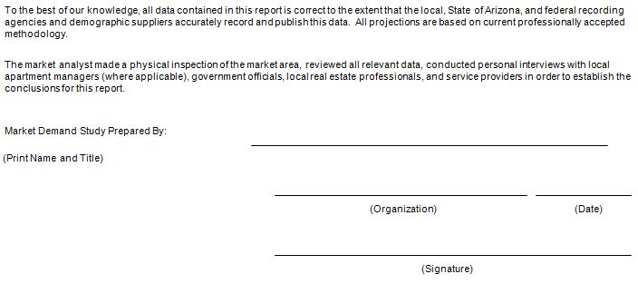
HOME Market Demand Study
This year agencies applying for HOME funds will need to complete
a HOME Market Demand Study and Market Demand Study
Certification.
Please complete Market Demand Study, Prepared by Section of
the Certification captured below:
Notes:
This year agencies applying for HOME funds will need to complete a HOME Market Demand Study and Market Demand Study Certification.
Please reference and adhere to the market demand study rules and guidelines when completing the HOME Market Demand Study
The HOME Market Demand Study can be submitted in a separate WORD document. Please be sure to cite all data sources used.
After completing the HOME Market Demand Study, please have the preparer complete the Market Demand Study Prepared by section of the Market Demand Study Certification captured on the slide.

Slide 29
CHDO Certification and Qualifying Criteria
Certification Form of Low-Income Status for CHDO
Board Members
Board Resolution (if applicable)
Notes:
This year, if you are submitting a HOME Proposal as a CHDO, a Certification Form will need to be completed for each Low-Income Status Board Member of the CHDO, and if applicable, a Board Resolution may be required to demonstrate specific items listed on the CHDO Checklist within the HOME Proposal.

Slide 30
Monitoring Process
Focus on performance:
Regulatory compliance
Financial Management Documentation
Reporting
Notes:
The monitoring process only applies to CDBG and HOME,
it focuses on:
Measuring agency performance in accordance with applicable regulations
Financial Record keeping
and Reporting (in preparation for the monitoring process it is important to ensure that both ethnicity and race are captured in your monthly performance reports).
Monitoring helps to ensure compliance with federal and local requirements, while also giving us an opportunity to provide technical assistance to strengthen your program.

Slide 31
Quarterly Reporting
Focus on:
Number of Scottsdale persons or households to be assisted
Demographics
Income Levels
Due by the 10th of July, October, January and April
Notes:
Monthly reports focus on:
The number of Scottsdale persons or households to be assisted
Beneficiary demographics
And beneficiary income levels
Quarterly reports are due on the 10th of July, October, January and April regardless of lack of activity
It is important for us to receive the reports on time in order to accurately provide this information to HUD.

Slide 32
Reimbursement Requirements
Comply with all insurance requirements
Copies of supporting documentation (e.g. timesheets, payroll ledgers, invoices and proof of payment)
If paying for salaries must be able to identify time spent to Scottsdale funded activity (direct services)
  Ineligible reimbursement expenses include, but are not limited to over-time, paid time off and retro pay
Submit ONLY one (1) copy of your reimbursement request
Notes:
The following is an overview of the reimbursement requirements:
Agencies must comply with all insurance requirements.
They must provide copies of supporting documentation such as timesheets, payroll ledgers, invoices and proof of payment.
If the activity includes salaries the agency must be able to identify the time spent on the Scottsdale funded activity.
Salaries for over-time, paid time off and retro pay are ineligible for reimbursement.
Submit ONLY one (1) copy of your reimbursement request – either by email or hard copy.
I will now turn it over to Michele Payakovich, who will discuss Scottsdale Cares, General Funds, Endowment and Proposal Submissions.

Slide 33
Scottsdale Cares
Notes:
Thank you Justin.
Scottsdale Cares is the City of Scottsdale’s voluntary utility donation program and receives approximately $12,271 each month from Scottsdale residents and businesses.

Slide 34
Eligible Activities
Promote the positive development of youth, adults and seniors
Strengthen the capability of families and the self-sufficiency of adults
Assist Scottsdale residents of all ages to address crisis needs
Notes:
- Scottsdale Cares promotes the positive development of youth, adults, and seniors
- Strengthens families and the self sufficiency of adults
- or supports residents in addressing crisis needs.

Slide 35
Anticipated Allocation
$150,000 from Utility Bill Donations to the Scottsdale Cares Program
Amount Tentative as its appropriated by the City Council
Notes:
The estimated allocation for Scottsdale Cares for FY 2021/22 is $160,000.
The amount available is tentative until it is approved by City Council in June of 2021.

Slide 36
General Funds
Notes:
The City of Scottsdale funds non-profit agencies to conduct human service programs in Scottsdale.

Slide 37
Eligible Activities
Brokerage Services (agencies providing services in City of Scottsdale Human Services facilities)
Domestic Violence Shelter Services
Legal Services
Regional Shelter Services
Services for Seniors
Notes:
The following are Eligible Activities to facilitate with General Funds:
(read the bullet points)

Slide 38
Anticipated Allocation
$200,000 from the City of Scottsdale General Funds
Amount Tentative as it is appropriated by the City Council
Notes:
The estimated allocation for General Funds for FY 2021/22 is $200,000;
This amount available is tentative until it is approved by City Council in June of 2021.

Slide 39
Reimbursement Requirements for Scottsdale Cares and General Funds
Must meet number of Scottsdale persons or household to be assisted from Scope of Work
Comply with all insurance requirements
Invoices and Performance Reports
  Contracts under $25,000, request are due:
    October 20th, February 20th and June 20th
  Contracts over $25,000, requests are due:
    September 20th , December 20th, March 20th and June 20th
Submit only one (1) copy of your invoice, reimbursement request – by email
Notes:
For Scottsdale Cares and General Funds, agencies must comply with the following:
Must meet the number of Scottsdale persons or household to be assisted from your Scope of Work. For instance: When we are processing your reimbursement requests,
we will verify that you are performing appropriately towards meeting your goals indicated in your SOW.
If you fall short or do not meet the total number of Scottsdale persons or households to be assisted you will not be reimbursed.
You will also need to: Comply with all applicable insurance requirements, City ordinances and state and federal laws and regulations.
This year we have new deadline schedules for invoices and performance reports, they are as follows:
Contracts under $25,000 ; Invoices and Performance Reports are due on Oct. 20th, Feb 20th and June 20th.
Contracts over $25,000 ; Invoices and Performance Reports are due on Sept. 20th, Dec 20th, March 20th and June 20th.
Submit ONLY one (1) copy of your reimbursement request – by email.

Slide 40
Endowment Funds

Slide 41
Endowment Fund Categories
Qualifying organizations shall be either City of Scottsdale programs or organizations that are tax exempt under Section 501(c)(3) of the Internal Revenue Code.
The Scottsdale Community Endowment Fund
is used to carry out the purposes of community
projects and programs for the public good within
the city
The Herbert R. Drinkwater Youth Fund is used to support City of Scottsdale youth programs
Notes:
The City of Scottsdale Endowment Funds are awarded on a competitive basis. City of Scottsdale programs and agencies recognized by the Internal Revenue Service as 501(c)(3) agencies are qualified to apply.
Eligible activities for the Scottsdale Community Endowment are community projects and programs for the public good within the City of Scottsdale. There is estimated to be approximately One Thousand Three Hundred Dollars ($1,300) available.
The Herbert R. Drinkwater endowment is used to support City of Scottsdale youth programs. Estimated to be approximately Seven Hundred Dollars ($700.00).

Slide 42
Anticipated Budget
A total allocation of $8,700 is expected to be available, between the two funds.
Amount Tentative until appropriation is approved by the City Council
Notes:
A total allocation of $8,700 is expected to be available, between the two funds.
This amount is tentative until it is approved by City Council in June of 2021.

Slide 43
Reimbursement Requirements
Comply with all insurance requirements
Submit only one (1) reimbursement request invoice on agency letter head either by email or mail on January 15th
Agencies check will be disbursed by the Arizona Community Foundation
Notes:
For Endowment Funds, agencies must comply with all applicable insurance requirements, City ordinances and state and federal laws and regulations.
Agencies are required to submit 1 Invoice on agency letter head – either by email or mail on January 15th; please include:
Date of Request
Name of funding source (Endowment Funds)
Total amount requesting (full allocated amount)
Funding year (FY21/22)
Any documents/data agency has collected regarding the number of assisted Scottsdale persons as of January 15th, 2021
All agencies will receive 1 check for the full awarded amount.

Slide 44
Proposal Submission

Slide 45
Proposal Submittal for
All Funding Sources
1 signed electronic copy of the proposal and completed checklist, single sided
Faxed submissions will not be accepted.
All material submitted must single sided on standard white 8½ x 11 paper.
Do not include extraneous material, unnecessary packaging, letter of transmittal or cover letter.
Your proposal(s)must be submitted in Word format only to: HSGrants@ScottsdaleAZ.gov (electronic signatures are acceptable)
Notes:
The proposal checklist states that you will need to submit each proposal two ways.
A signed electronic copy of the proposal and completed checklist, single sided, must be submitted to the Community Assistance Office along with the requested supporting documentation.
Faxed submissions will not be accepted. All material submitted must be single sided on standard, white, 8½ x 11 paper.
Please do not include extraneous material, unnecessary packaging, a letter of transmittal or a cover letter.
Your proposal(s) must be emailed in Word format only, to HSGrants@ScottsdaleAZ.gov (electronic signatures are acceptable). If awarded funds in FY2021/22, your scope of work will be extracted from this document and incorporated into the final contract. I cannot stress enough, please submit your proposal in the original WORD format only. If you do not receive a reply to your electronic submission from our office, then please contact us. Your email could have been directed into a spam folder.
In addition, please follow the directions provided on each proposal’s checklist.

Slide 46
BUDGET Submittal for All Funding Sources
Notes:
SLOW DOWN SPEECH
Budget Page 1 of 2, Question 9, is an overview of the three categories agencies can utilize for developing their budgets, Personnel Services, Contracted Services and Supplies and Miscellaneous.
We have color coded each of the sections to coincide with the Total Program Budget Summary page that will be covered on the next page.
In the example above we provided each category, color coded and instructions on how the categories are to be completed.
Red Personnel Services 1 and 4:
- Personnel Services incorporates position title, salaries, hourly rate and ERE
Please note the calculations are included for each line item
Total salaries added up total $4,082, ERE Totals $60
Total category cost is $4,142.00
Green Contracted Services 2 and 5:
- Contracted Services incorporates professional services the agency pays for, such as vehicle insurance, vehicle maintenance and gas.
Please note when requesting reimbursement for mileage/travel to include the mileage rate in the calculation
Total category cost is $6,190
Blue Supplies and Miscellaneous Services 3 and 6:
- Supplies and Miscellaneous incorporates items needed by the agency to run the project
These items include supplies, first aid and copies.
Total category cost is $668
Each line item and the total amount requested in each category must match on the Total Program Budget Summary page, which is Budget Page 2 of 2.

Slide 47
BUDGET Submittal for All Funding Sources (continued)
Notes:
The completed example above of the Total Program Budget Summary page, must reflect your requested amounts for each line item from your Budget page 1 of 2, question 9 for each category. Please verify all calculations for all columns and rows add up correctly.
Above you will see the arrows are distinguishing each column and row that needs to total. Red for Personnel Services (1 & 4), Green for Contracted Services (2 & 5) and Blue for Supplies and Miscellaneous (3 & 6).
Under “Revenues” please list all sources of funding for your activity.
Column “A” – Requested funds from the City of Scottsdale only, verify total for this column (7), matches your total requested amount for this activity.
Column “B” – All other funding sources.
If you have a line item specified on your Budget page 1 of 2, question 9, that is not shown on this Total Program Budget Summary page, you can add that line item under “Other” and then specify what the line item is (8).
Please identify Committed funding with a “C” or Tentative funding with a “T” in the 4th column.
The SumTotal of (A+B), are totals of all funding sources for each line item.
Please make sure you follow these steps when completing the budget for your activity.

Slide 48
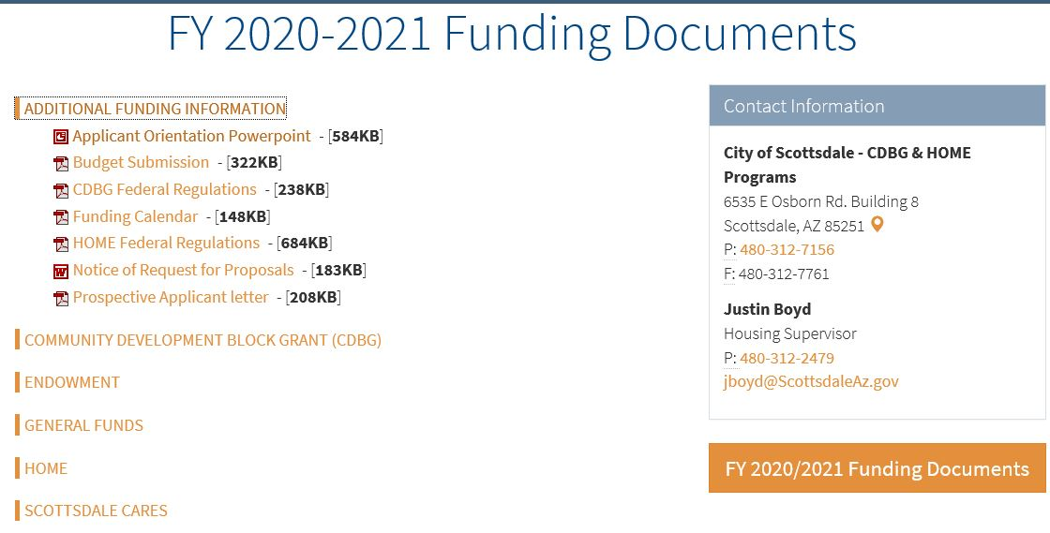
Budget Website
Notes:
We have additional Budget Submission Instructions available on our website.
If your agency does not adhere to the format identified on the proceeding slides and the example provided on the funding documents web page for Budget page 1 of 2, Question 9, your agency will be required to revise this section of the proposal during the Human Services Staff Evaluation process in December.
If you have additional questions, please contact myself or Justin Boyd.

Slide 49
Staff Contacts for questions or concerns:
CDBG Public Service CDBG Housing CDBG Facilities HOME Scottsdale Cares General Funds Endowment Funds Program Budget Technical Assistance | Justin Boyd Housing Supervisor (480) 312-2479 jboyd@scottsdaleaz.gov Michele L. Payakovich Community Grants Specialist (480) 312-2576 mpayakovich@scottsdaleaz.gov
Notes:
Here are the staff contacts for your questions or concerns when you are developing your Proposals.
These contacts are also available on our funding webpage.
Business cards can also be provided per your request.
NEW: NOTE: We would like to reminder everyone that if your agency is funded multiple times in the same year, when you have your insurance producers create your Certificates of Insurance and Workers Comp. Insurance, please inform them that they can include all contract numbers on the same COI. We do not need a separate COI for each contract.
I will now turn it back over to Justin Boyd.

